Slide 1

IOT / Wearables
Session Chair:
Darryl Ackley, ICASA - NMT
Panelists:
William Kwan
James Wernicke, Los Alamos National Lab
Ron Tafoya, RESPEC & ISC² NM Board
Cybersecurity Entrepreneurship Workshop
September 27, 2019

Slide 2
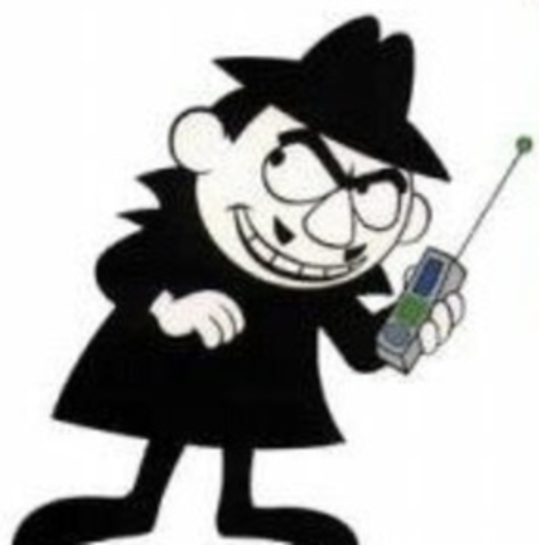
Security & Privacy Topics
IOT/Wearables
  What are the benefits?
  What are the trade-offs?
  What are the specific cybersecurity concerns?
  What are the specific privacy concerns?
  What does the future hold?

Slide 3
Market Definition and Analysis
IOT/Wearables
  What is privacy worth?
  What are the ethical issues?
  Are there alternative paradigms?
  What are the market opportunities?

Slide 4
Cyber Tech Competition
Competition Instructions
  Select a Spokesperson for your table
  Answer the posed questions as best you can – remember, there are no wrong answers!
  Ask for help if necessary. People will be in your vicinity.
  Work together and involve everyone at your Table.
  Produce brief written responses to the questions using the form on your table.
  The Spokesperson for the winning team will be asked to briefly present critical points in the final session.

