Slide 1

Signing off Transactions,
The 17 Step Process

Slide 2
Signing Off Transactions
Step 1
Scan and save all available receipts to a folder on your computer. Name the files something familiar so you can attach them later.

Slide 3
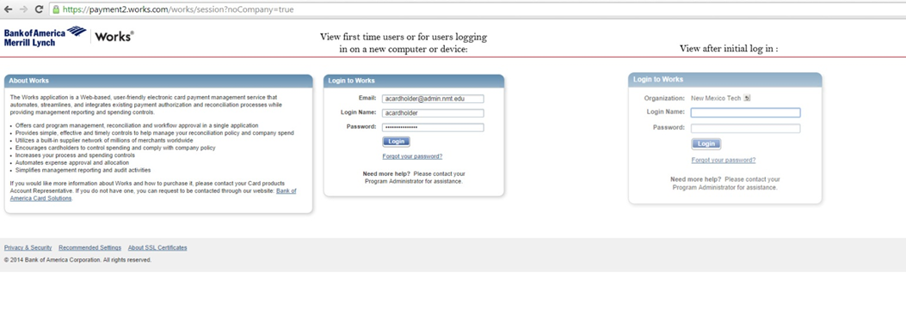
Signing Off Transactions
Step 2
Login to Works by clicking the following link: https://payment2.works.com/works/home
Enter your username and password. (New users and users using new devices will need to enter their email address the first time they login).

Slide 4
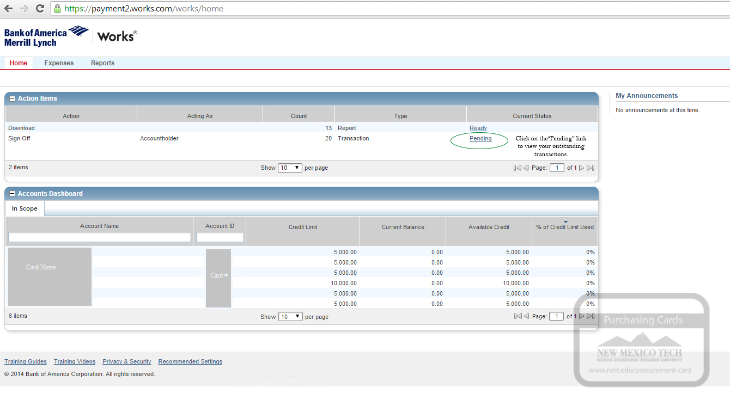
Signing Off Transactions
Step 3
From your home screen click on the “pending” link.

Slide 5
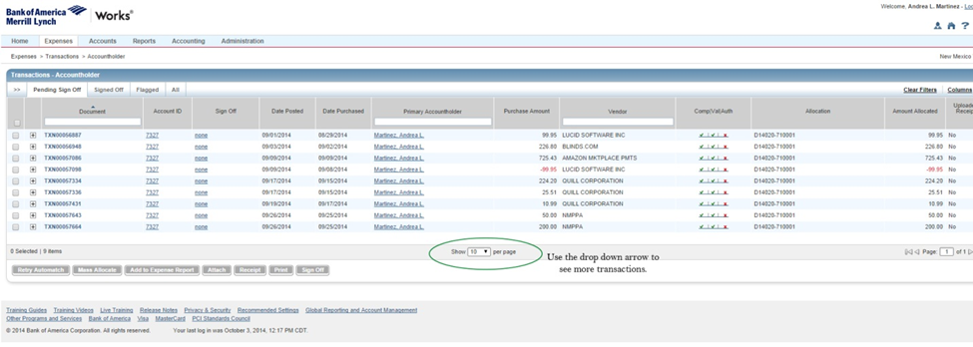
Signing Off Transactions
Step 4
You will see a list of all your outstanding transactions. If you have more than 10 transactions you can click on the drop down arrow on the bottom of the page to view more transactions per page.

Slide 6
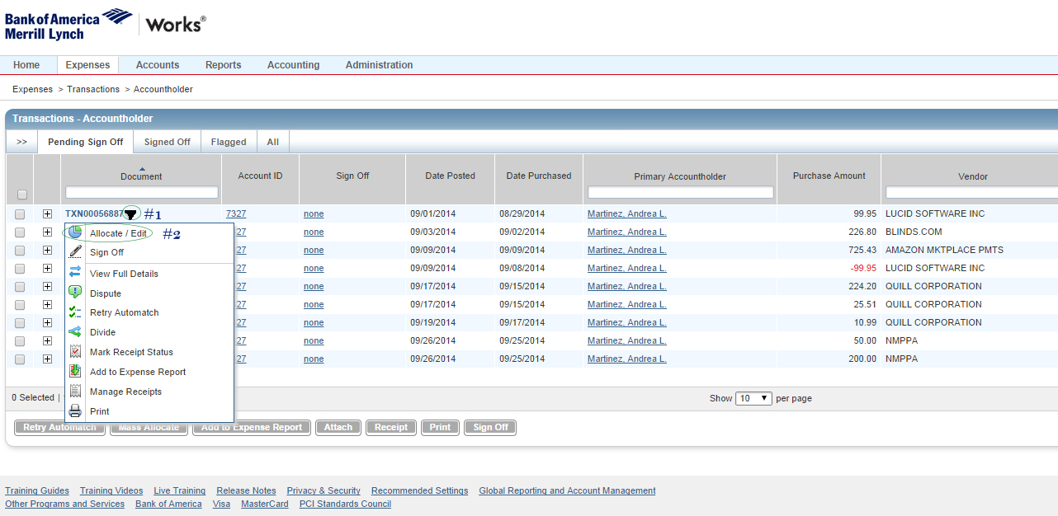
Signing Off Transactions
Step 5
Click on the right side of the TXN000# ( #1) and a drop down arrow will appear. Choose “Allocate/ Edit” ( #2)
A new page will pop up (See next Slide.) On this page you can allocate your FUND/ Account , add additional FUNDS/ Accounts , Update the Tax status , and add a business description.

Slide 7
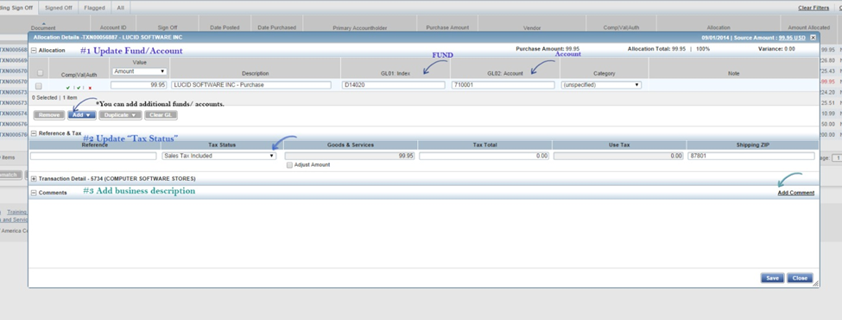
How to Signoff on a transaction
Step 6
a. Check your index (FUND) and your account numbers to make sure they are correct. If they need to be changed click in the box and update the information.
b. Change your tax status. “Non- taxable” for goods and “ Sales tax included” for services.
c. Click on add comment and write a description for the items you purchased.
d. Press the “Save” icon.
e. Press the “Close” icon

Slide 8
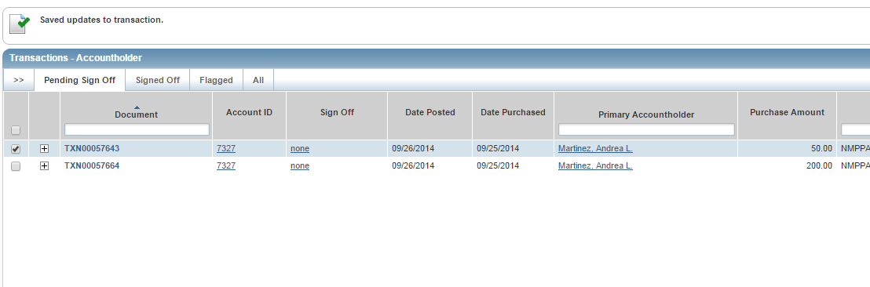
Signing Off Transactions
Step 7
After you press “Close” you will be taken back to the transaction home page.

Slide 9
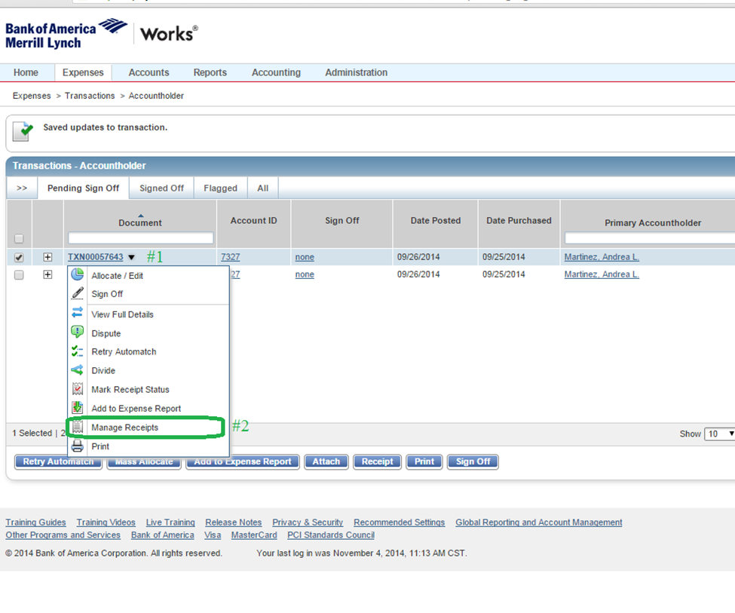
Signing Off Transactions
Step 8
From the transaction home page click on the transaction TXN again (#1) and select “Manage Receipts” (#2)

Slide 10
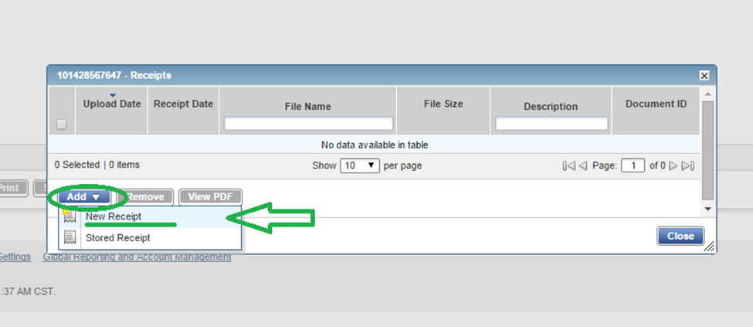
Signing Off Transactions
Step 9
A new window will appear. Click on the “Add” icon and select “New Receipt”.

Slide 11
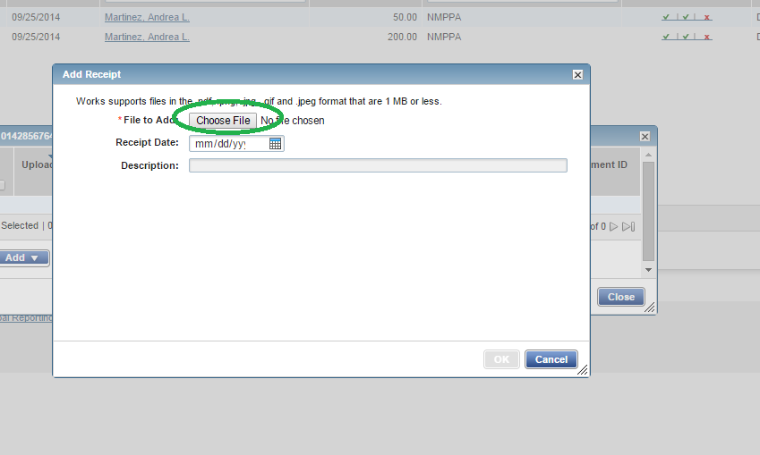
Signing Off Transactions
Step 10
A third window will appear. Click on “Choose File”

Slide 12
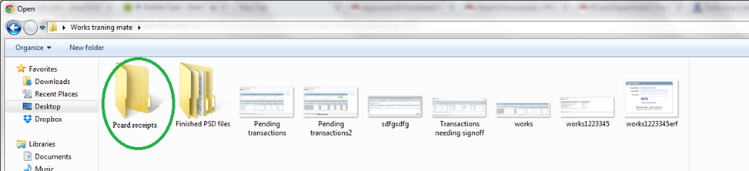
Signing Off Transactions
Step 11
This will open your computer files . Find the folder with your scanned receipts and attach the correct receipt to the transaction.

Slide 13
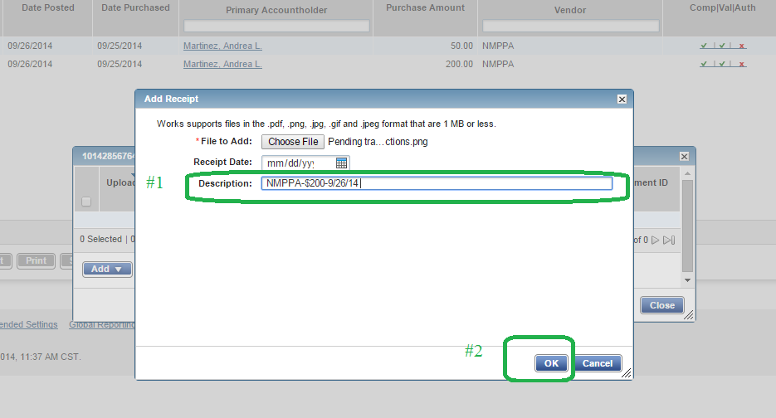
Signing Off Transactions
Step 12
Add a description
Press “ok”

Slide 14
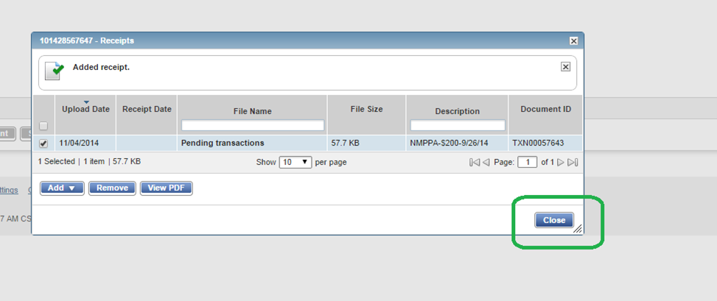
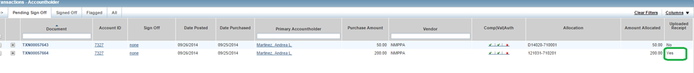
Signing Off Transactions
Step 13
Press “Close”
*Your receipt is now uploaded to the transaction.

Slide 15
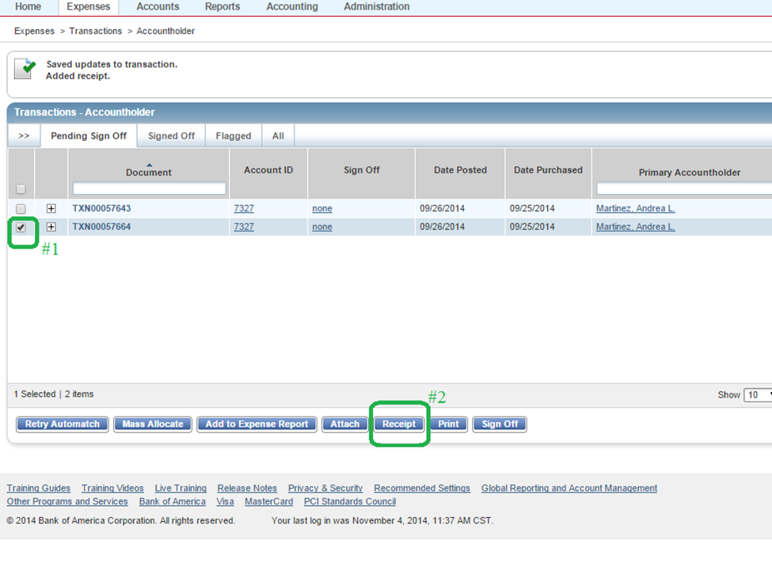
Signing Off Transactions
Step 14
#1 On the transaction home page select the correct transaction.
#2 Press the “Receipt” icon.

Slide 16
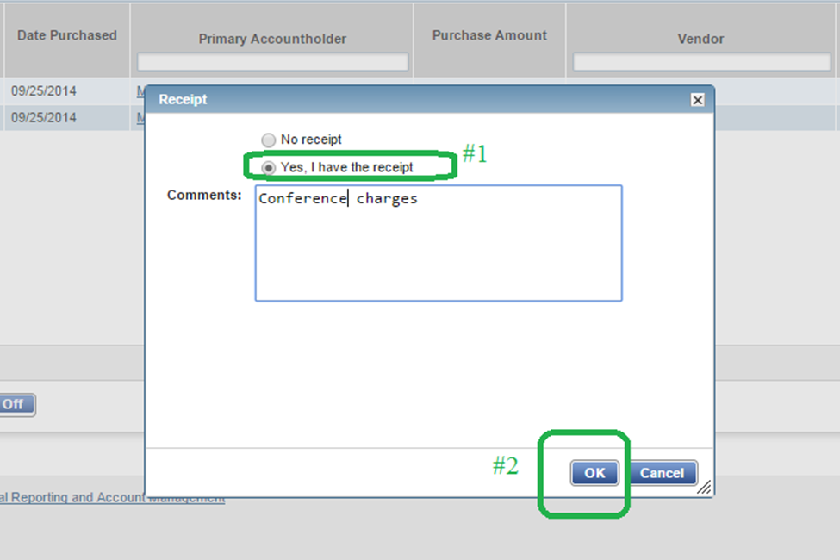
Signing Off Transactions
15 of 17
#15. A new screen will appear. Check “ Yes, I have the receipt” ( #1) and leave a short comment. Press “Ok”(#2)

Slide 17
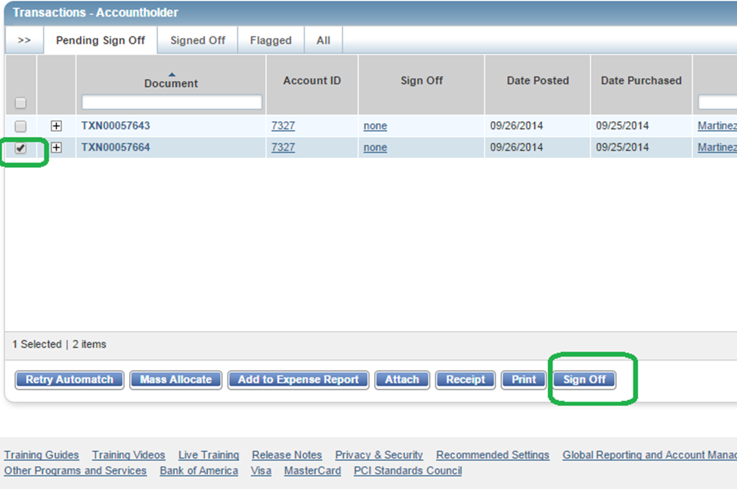
Signing Off Transactions
Step 16
Check the transaction you want to sign off. Click the “Sign-Off” icon. A new winnow will appear . Press “OK”

Slide 18
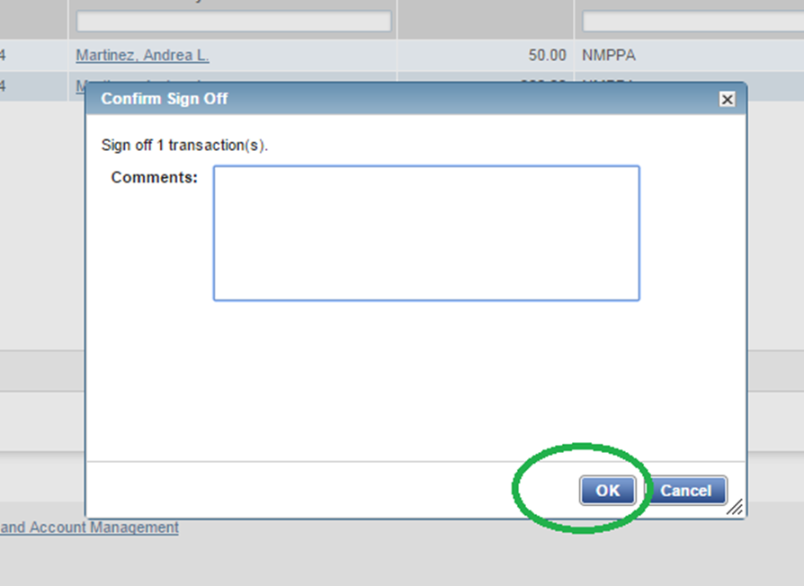
Signing Off Transactions
Step 17
Press ok.
And move on to the next transaction.

Slide 19
Questions
?

