Slide 1
How To run a spend report

Slide 2
How to Run a Spend Report 1 of 12
Click on the “Reports” tab → Select “Create”. This will take you to a new screen.

Slide 3
How to Run a Spend Report 2 of 12
Under the “Create Report” screen choose:
#1. Category = Spend
#2. Template= “Choose from all available templates”

Slide 4
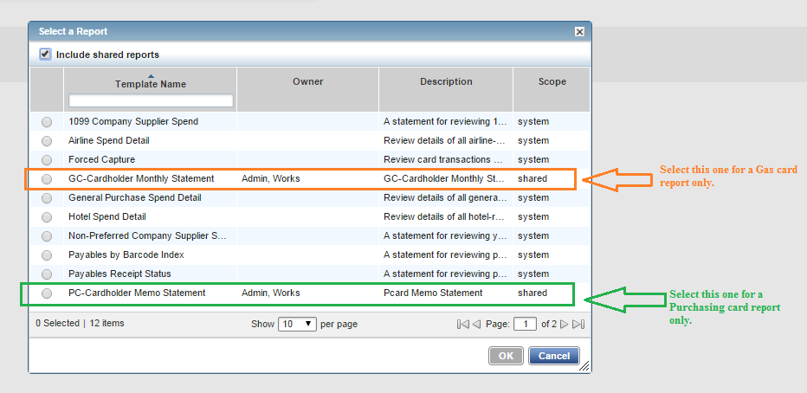
How to Run a Spend Report 3 of 12
Select GC- Cardholder Monthly Statement for Gas cards
Select PC- Cardholder Monthly Statement for Purchasing cards
Press ok

Slide 5
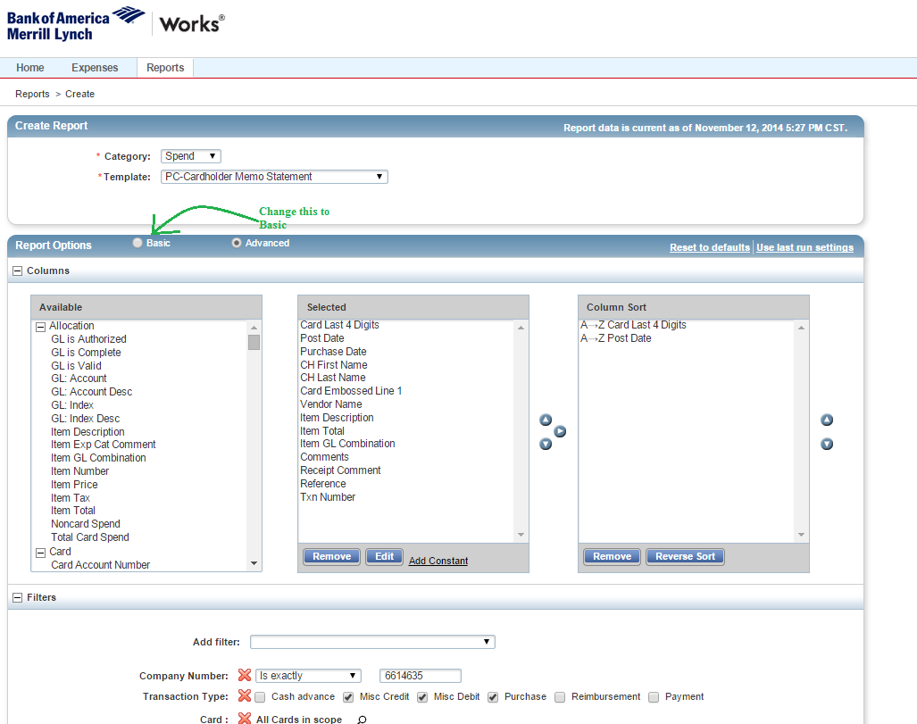
How to Run a Spend Report 4 of 12
Your card is defaulted to “Advanced” report options but you will only need the “Basic” options so please change to “ Basic”. You will only need to do this once.

Slide 6
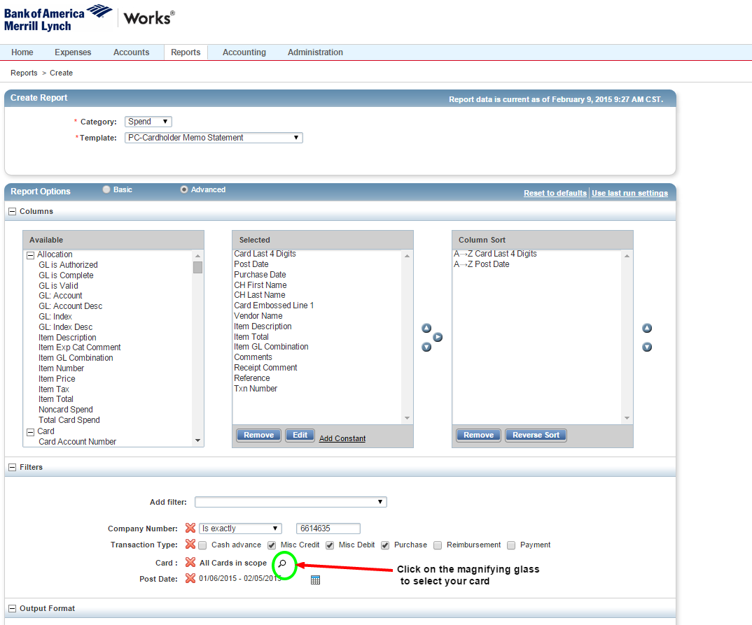
How to Run a Spend Report 5 of 12
To select your card, click on the Magnifying glass.
If you skip this step your report will list all of the purchase cards that belong to Tech.

Slide 7
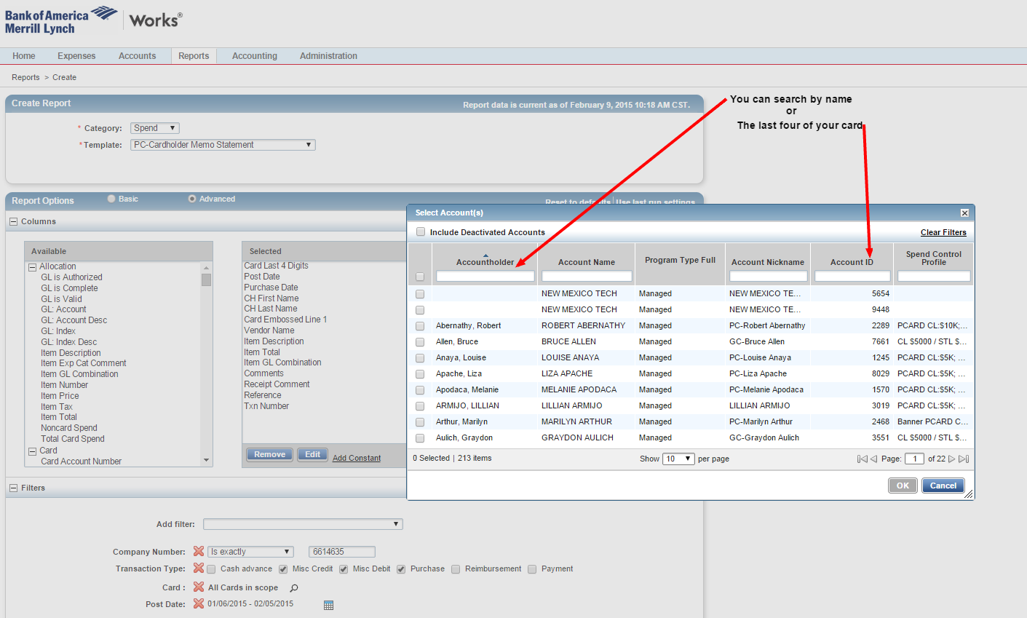
How to Run a Spend Report 6 of 12
You can either enter your name in the Accountholder box , (Works will find you by your last or first name), or enter the last 4 digits of your card in the Account ID Box.
It is recommended to use the Account ID.

Slide 8
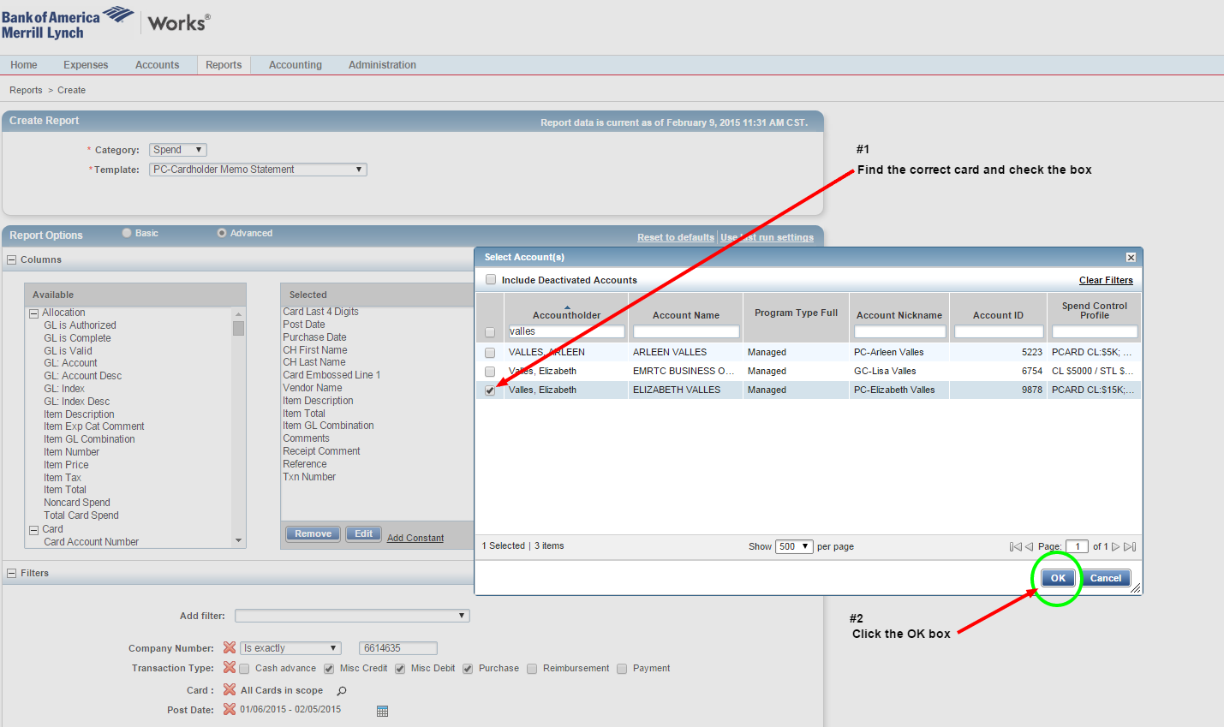
How to Run a Spend Report 7 of 12
If you entered your last name as the Accountholder, all cards with the selected name will be listed
#1 Find the correct card and check the box.
#2 Click the OK box.

Slide 9
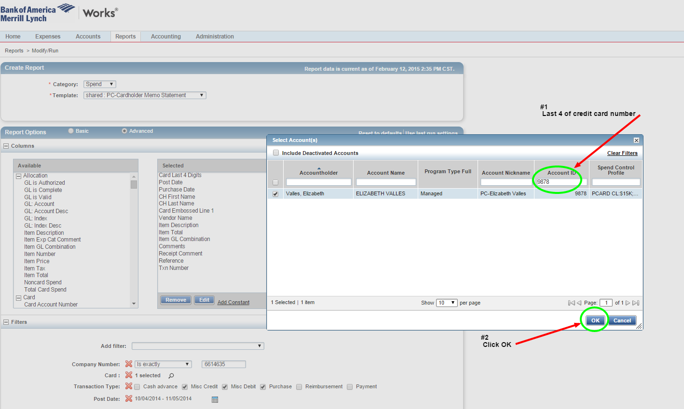
How to Run a Spend Report 8 of 12
Using the recommended Account ID method.
#1 Enter the last 4 digits or your credit card number in the Account ID box.
#2 Click the OK button.

Slide 10
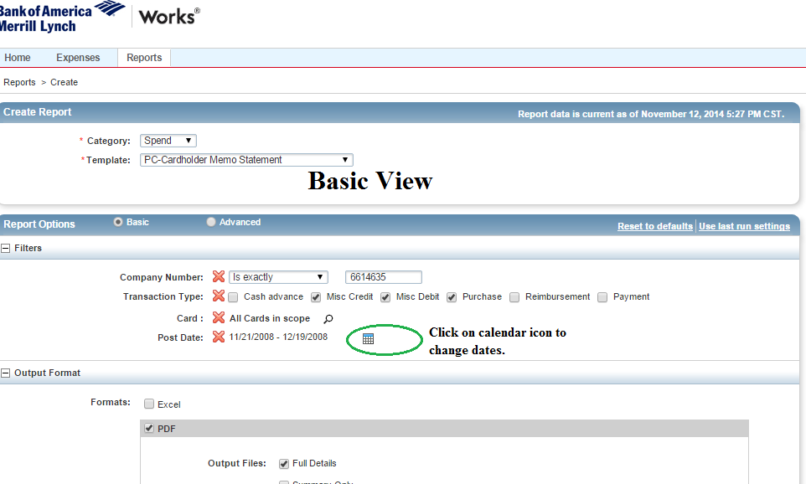
How to Run a Spend Report 9 of 12
You will now need to select the dates of the report.
When you click on the calendar icon a new screen will pop up and give you different date options.

Slide 11
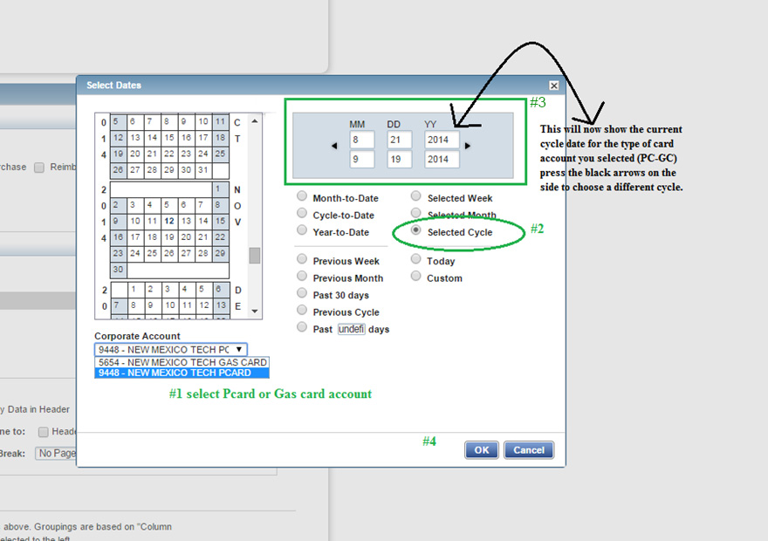
How to Run a Spend Report 10 of 12
#1. Pick the card account you need
#2. Check “ Selected Cycle”
#3. This will default to the current statement.
#4. Press ok
* You can use the black arrows to choose different dates.

Slide 12
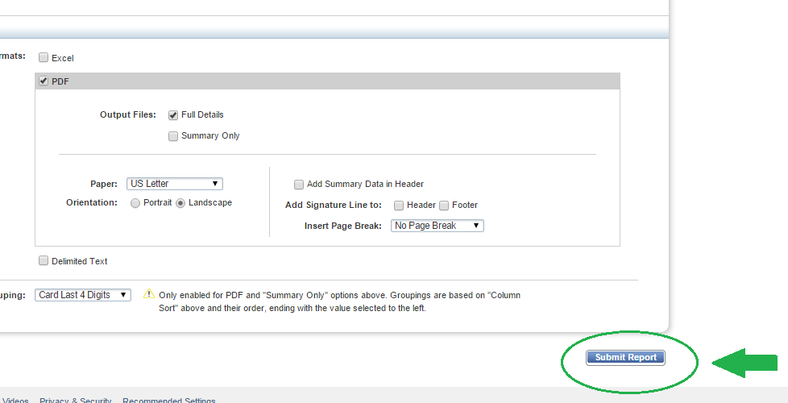
How to Run a Spend Report 11 of 12
This will take you back to the previous screen.
Scroll down and press “ Submit reports”

Slide 13
How to Run a Spend Report 12 of 12
Wait for your report to download
Double click PDF to open and view your report.

Slide 14
questions
?

