Slide 1
Human Subjects Research (HSR)at NMT
An Overview for Researchers

Slide 2
Is it HSR?
If you’re working with quantities, counts, or tallies of items: Not Human Subjects Research.
If you’re interacting with people, even just a little bit: It’s Human Subjects Research.

Slide 3
HSR must follow federal laws
All Human Subjects Research must follow federal rules that dictate:
Whether your project is approved.
How you recruit participants
How you treat participants
How you store your data
How you wrap up your project and dispose of your data.

Slide 4
Why were HSR laws enacted?
Many HSR projects have been performed despite being unethical, hazardous, or even cruel.
Many HSR projects caused severe harm to -- or even killed -- people who served as their subjects.
Federal research funding increased significantly post-WWII, thus increasing the potential for abusive treatment of subjects.

Slide 5
Tuskegee Syphilis Study
Black sharecroppers in Alabama were used to track the natural history of untreated syphilis infections.
The research was specifically designed to track the course of the disease, NOT cure it.
Ran from 1932 to 1972 – continued well after drugs were available to cure syphilis infection.

Slide 6
Nazi and Japanese Atrocities during WWII
Inmates of both Nazi and Japanese concentration camps during WWII were tortured under the guise of medical research.
Exposed to diseases or extreme heat or cold, injected with toxins, surgery or vivisection without anesthetics, etc.

Slide 7
DOE Experiments
Ionizing radionuclides were injected into or ingested by children and young adults without their knowledge or consent.
Conducted under the guise of national security by the United States Atomic Energy Commission and Department of Energy during the Cold War.

Slide 8
History of Federal HSR Laws
Federal laws governing HSR began in 1974 with the National Research Act.
Other laws enacted throughout 1970s and 1980s
Common Federal Policy for the Protection of Human Subjects ("Common Rule") passed in 1991, adopted by 16 federal agencies.
The Common Rule currently governs federally-funded HSR in the United States.

Slide 9
A Basic Summary of The Common Rule
ALL human subjects research conducted or funded by a Federal Department or Agency must be governed by an Institutional Review Board. (CFR Section 46.101)
Federal Policy (Common Rule, Section 103a) states that "awardees and their collaborating institutions become ‘engaged’ in human subjects research whenever their employees or agents (i) intervene or interact with living individuals for research purposes; or (ii) obtain, release, or access individually identifiable private information for research purposes."

Slide 10
How long does The Common Rule apply to a project?
The rights and welfare of human subjects must be adequately protected during all phases of the research project, from inception through data collection, data analysis, writing up of results, and storage of the collected data at the project’s completion.

Slide 11
Who actually protects human subjects in research?
The Researcher – training courses online to acquaint them with the ethics involved in HSR and federal laws governing HSR.
The Institution, through a committee called an Institutional Review Board (IRB).

Slide 12
IRB responsibilities in HSR
Must be familiar with the rights of participants in HSR projects.
Must serve as the advocates for HSR participants -- not the institution or researcher(s).
Must ensure that HSR participants are treated ethically and humanely during their participation in such research projects.

Slide 13
IRB responsibilities, cont.
The IRB reviews all HSR projects conducted by Tech researchers – whether student or faculty.
All on-going research projects that involve human subjects are reviewed yearly, depending upon the level of risk.

Slide 14
Types of IRB Review
Projects are reviewed based on Federal Regulations.
Level of Review depends on:
Type of Data being collected
Level of Risk experienced by the subjects

Slide 15
Data Types
Data requiring a higher level of review (Personally Identifiable Data):
Name and/or SSN
Contact Info
Sensitive personal information
Medical data
Blood / Tissues / DNA

Slide 16
Definition of Risk
Risk can be emotional or physical
Low Risk: Anonymous surveys
Moderate Risk: Blood draw
High Risk: Some medical procedures
Sensitive personal or medical information – Can be very high-risk to person if information is revealed in the community

Slide 17
IRB Review Types
Administrative – for projects that do not collect personal information
Expedited – for projects that collect limited personal information
Full-Board – for projects using minors or projects that collect sensitive data

Slide 18
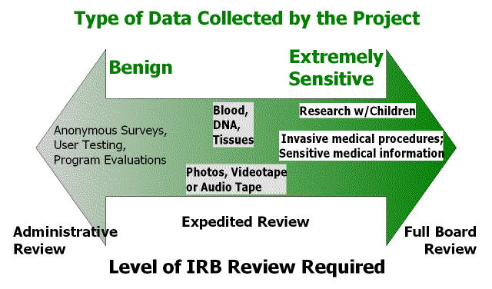
IRB Review Level

Slide 19
Forms and Documents
https://www.nmt.edu/research/irb.php

Slide 20
Contact Information
Email Application and Signature Form along with any surveys and consent documentation (Please NO paper)
Administrator/Chairman:
Val Thomas
Research Compliance Officer
Phone: 575-835-5749
Email: IRB@nmt.edu

