Slide 1
Truck Safety at Mines
Or, how to keep from getting run over, crushed, engulfed, electrocuted, die from a fall, or drown at a mine.

Slide 2
California mines share a common bond with California’s truckers.
Together, we supply the materials that help feed, build and maintain California.
It is a true partnership that is an important part of the foundation of California’s economy and growth.

Slide 3
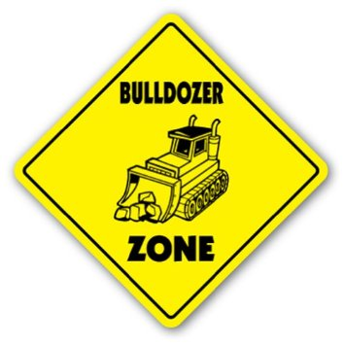
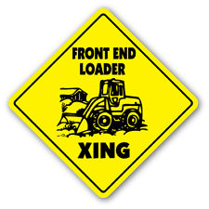
Because we all care for one another’s safety and well being, it’s important to understand the safety challenges to truckers and miners alike.
The number of trucks, their movement through mines and plants, their interaction with heavy equipment, smaller vehicles and workers on foot, volume of materials, the pace of activity, and the numerous hazards on mine sites must be everyone’s concern.
Our industries benefit from a mutual understanding of safe practices.

Slide 4
While there are many safety practices truckers are familiar with for driving on public roads, there are also a number of rules specific to mine sites.
Some of these rules may be specific to a mine site, others are mandated by Federal, State and even local regulatory agencies.
Failure for truckers to follow these rules can result in sanctions or fines or mine operations may prohibit a trucker from returning to a site for violation of rules.

Slide 5
Mining is an inherently dangerous operation. Despite advances in safety practices and regulation, there continue to be injuries and fatalities each year at mine sites.
When trucks enter mine sites, they are part of the mine work environment.
A high percentage of mine accidents and fatalities involve mobile equipment and trucks.

Slide 6
Heavy mobile equipment, such as loaders, scrapers, excavators, haul trucks, and water trucks.
Smaller vehicles, such as pickup trucks, vans, and delivery vehicles.
Workers on foot.
Obstructed Visibility. A mine site has many obstacles and conditions that obstruct a driver’s visibility. These include:
Heavy equipment
Stockpiles
Mine faces and contours
Dust
Night operations
Hazards
At
Mine
Sites

Slide 7
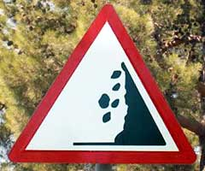
Mine Roadways can be a Challenge
Usually unpaved
Often narrow, elevated, and with obstructions
Change from time-to-time.
Can be rutted from use or rains
Low speed limits
May follow contours of the mine or stockpiles and, thus, have obstructed views
Falling Rock and Mine Walls
Quarry and pit walls can be unstable and result in falling rocks or slides of earth off a quarry or pit walls.

Slide 8
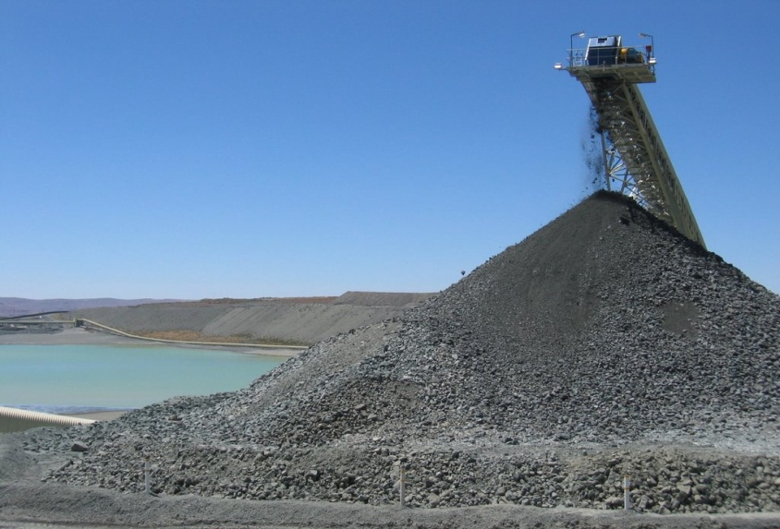
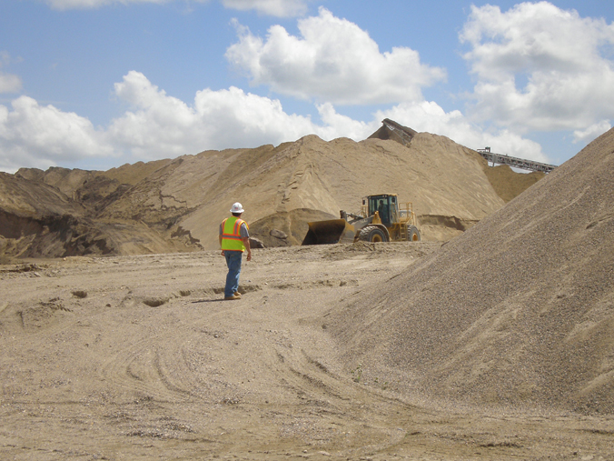
Stockpiles
Stockpiles of products, recycled material, or loose dirt pose several hazards
Can be an obstruction for driver’s visibility
Front end loaders and workers can be on foot in these areas
Stockpiles can also become unstable resulting in loose rocks or slides of entire piles

Slide 9
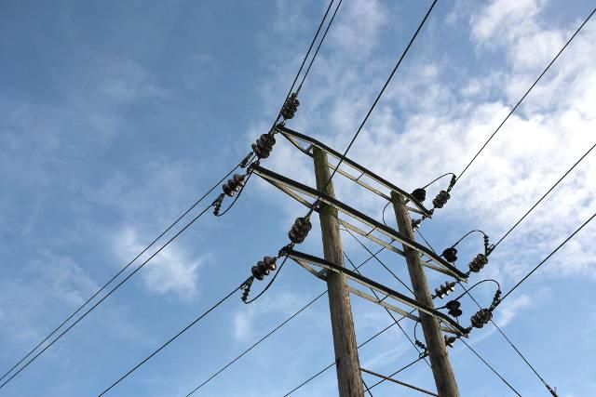
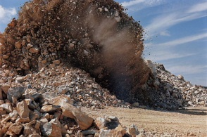
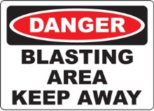
Overhead Lines & Objects
Be aware of overhead power lines or plant equipment.
Accumulation of dirt and materials on the ground over time may reduce clearances.
Explosives
Quarry and other hard rock mining operations conduct blasting operations.
Flying rock cannot always be controlled
Be aware of blasting activities and areas at the mine.

Slide 10
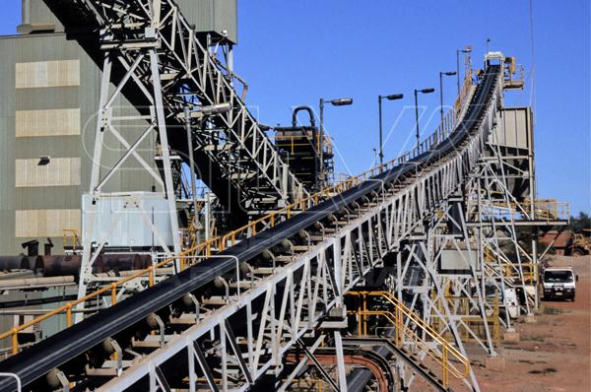
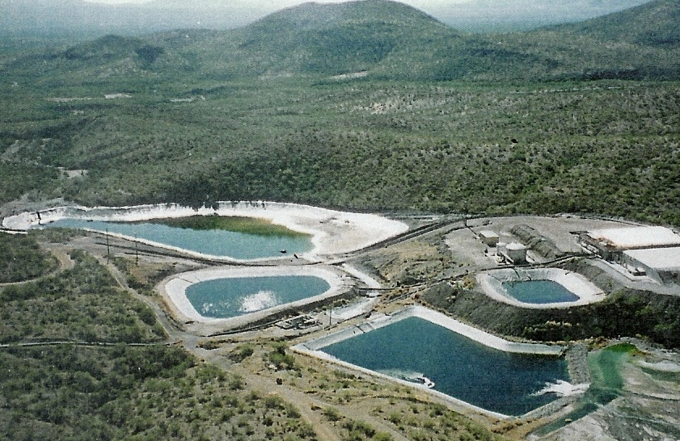
Plant and Processing Equipment
Conveyors, sorters, crushers, and other plant equipment are often continuously in operation.
May deposit material on roadway or shoot off rocks.
Loose clothing, hands, or feet that come in contact with the equipment can quickly entrap a person.
Electrical
High voltages, numerous cords, and charged equipment
Water Hazards
Lakes and ponds for dredging operations, flowing streams or rivers, ponds to accumulate water runoff, moisture on equipment and stockpiles, and puddles and muddy areas due to weather.

Slide 11
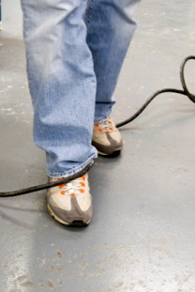
Tripping and Falling Hazards
Tripping and falling hazards are the most common type of hazards found in any work place.
Mines are inherently prone to tripping hazards from uneven surfaces, strewn rocks, discarded equipment, and chords on the ground.
Even paved areas can present tripping and falling hazards.

Slide 12
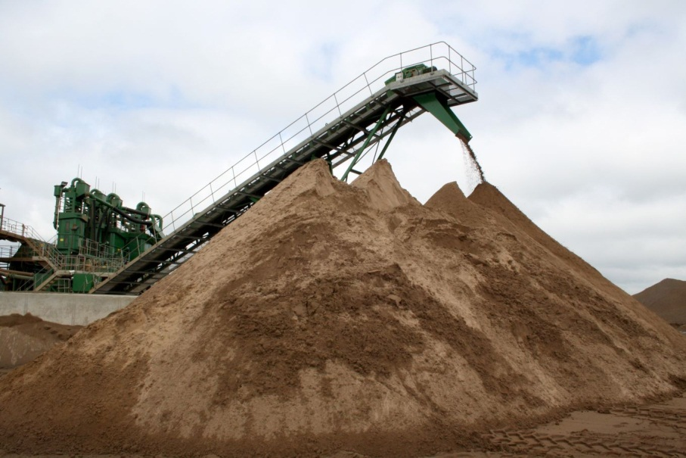
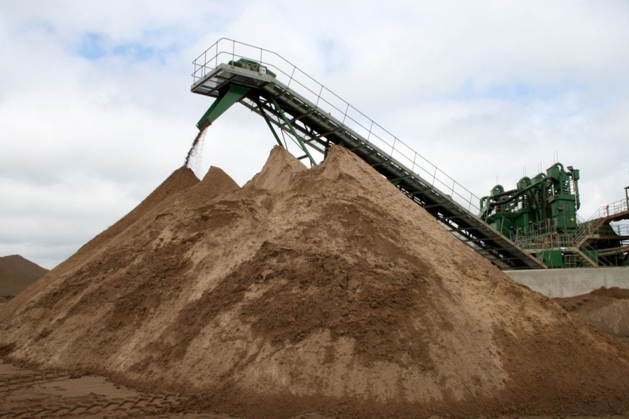
Changing Conditions
A mine, plant, roadways, or loading areas can be different each time a trucker arrives.
A mine pit can change due to more digging
Plant areas can be re-configured due to changes in location of materials or product needs.
Stockpiles can change in size, location, and number due to product demand.
Loading areas may change due to changed product stockpiles

Slide 13
Mine Site Training
MSHA requires that truckers travelling onto a mine get training in the specific hazards of that mine.
Safety signs also provide guidance to safety at the mine site.
This training is provided by the mine
To learn how to get this training, contact the scale house or mine company’s office.
Safety
Rules

Slide 14
Safety
Rules
Most crucial safety considerations
Loading areas
Relationship of the driver to the truck
Travel through the mine and plant area.

Slide 15
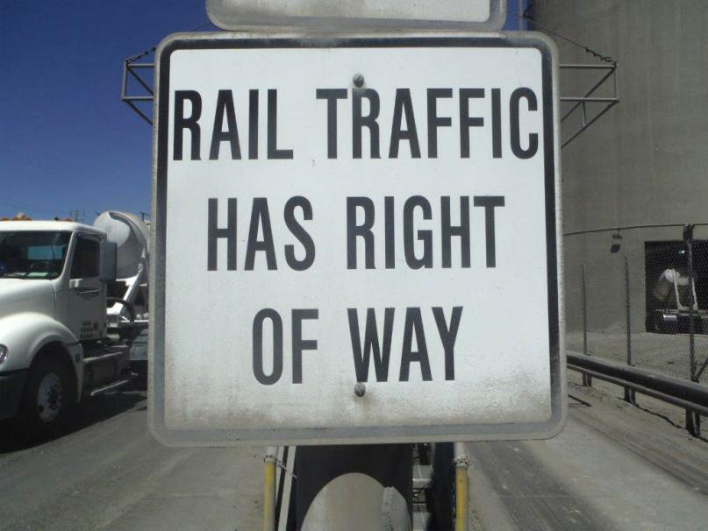
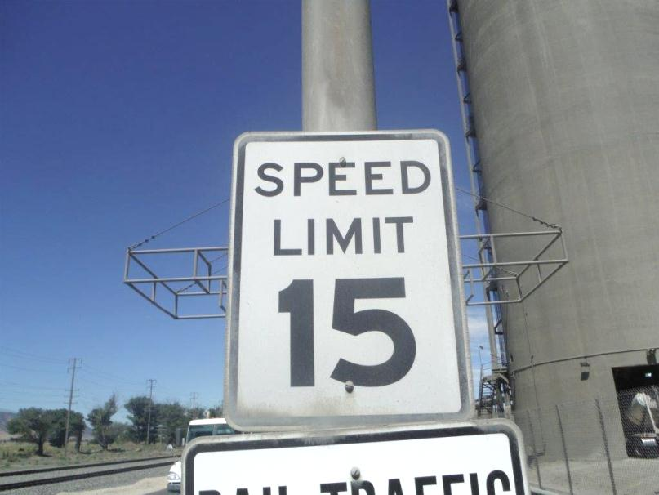
Follow Mine Traffic Rules
Each mine will have specific traffic rules.
These include speed limits, traffic patterns, and which side of the road to drive on.
These make travelling through the mine and plant safer for both the trucker and workers.

Slide 16
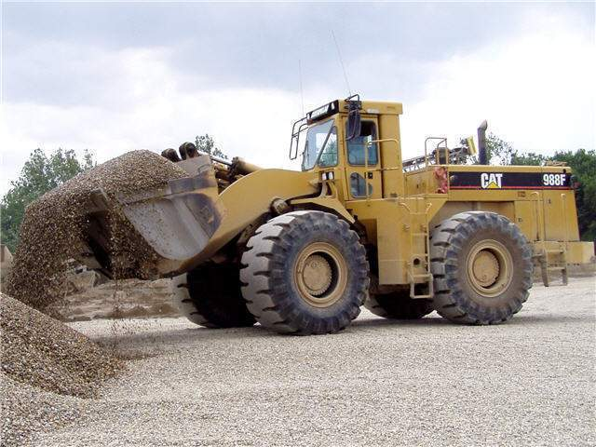
Wear seat belts
This is important for public roads as well as mine site travel, MSHA and CalOSHA can site the trucker for not wearing a seat belt on a mine site.
Yield to heavy equipment
Stop first.
Make visual contact with the heavy equipment operator
Wait until the operator motions you by, or he/she takes the right-of-way

Slide 17
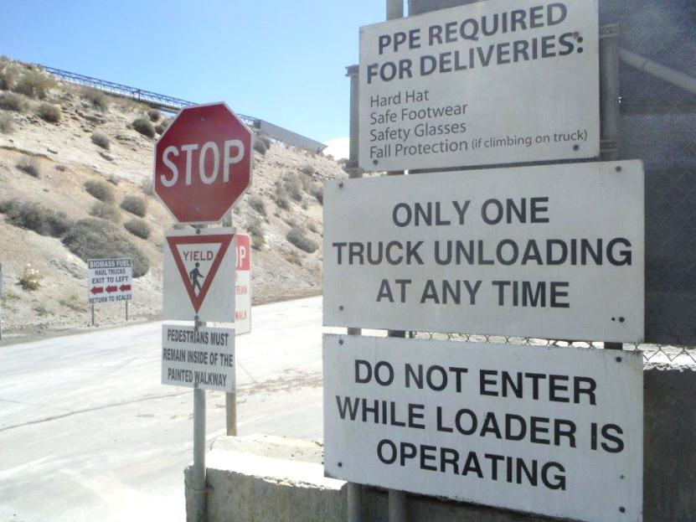
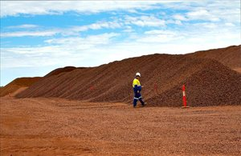
Stay Alert when travelling in loading areas
Watch for plant workers on foot
Watch for heavy equipment or smaller vehicles, such as pickups, and other trucks hauling aggregates
Stockpiles can create blind spots
Keep your speed down in these areas
Stay Back from Stockpiles
By staying a distance away, you will be more visible to other vehicles and the loader(s)
This also protects you from potential engulfment if stockpiles collapse
Do not stand, walk, park, or drive close to the base of a stockpile.

Slide 18
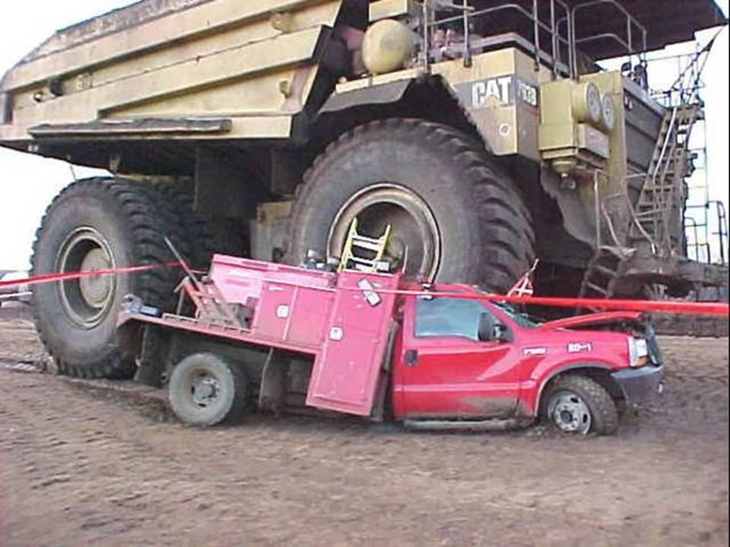
Do Not Pull In Behind a Loader or Heavy Equipment.
Heavy equipment operators have limited visibility.
If a loader is digging in a stockpile, or there is other heavy equipment stopped at the plant, stop well behind them.

Slide 19
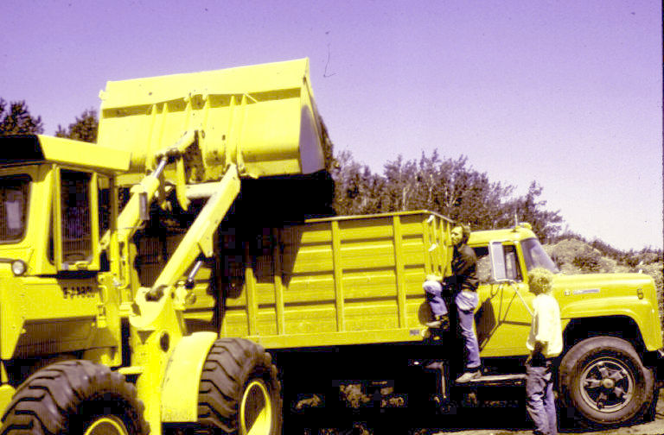
Stay In Your Trucks
If possible, stay in your truck!
Every time a driver steps out of their truck, the hazards for a driver increase.
Remaining in a truck is the single best thing a driver can do to protect themselves at a mine
If a driver does get out of a truck, wear hard hats, safety glasses, vests, and other protective equipment.

Slide 20
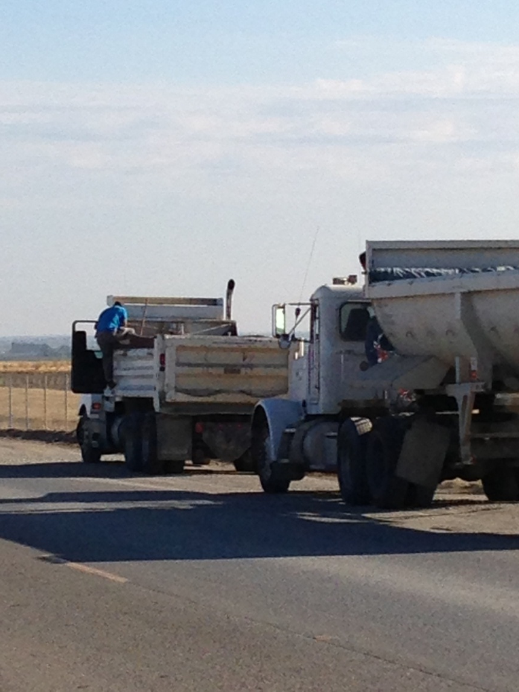
Do Not Climb on Trucks!
Every time a trucker climbs on a truck there is a possibility for a fall. Even falling 6 feet can kill a person.
This is a serious and common concern with truckers at mines.
Most mines prohibit climbing on trucks or trailers
MSHA can remove a driver and issue a citation.
Some mines may prohibit a driver from returning.

Slide 21
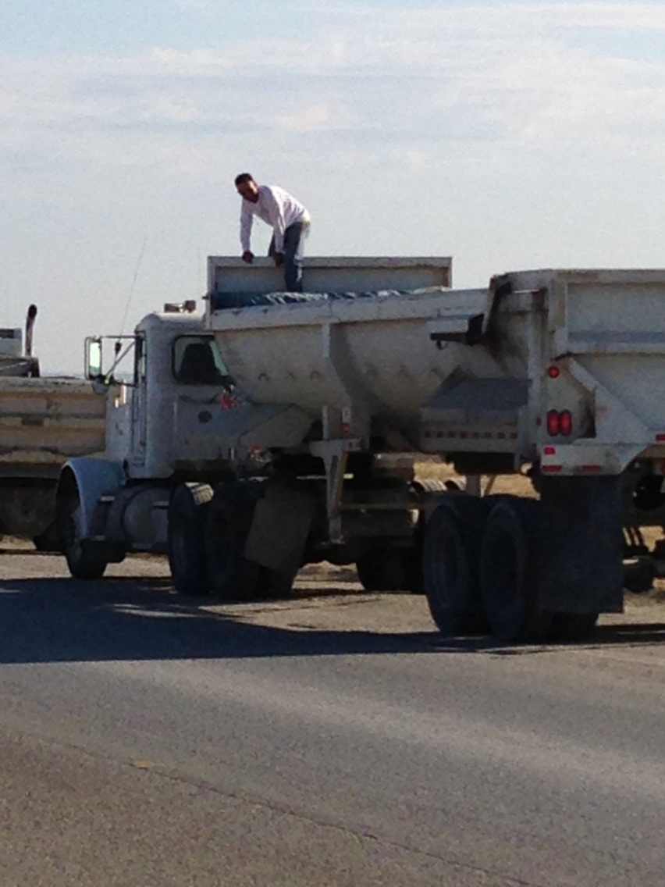
Do Not Climb on Trucks!
These are options to consider if there is need to trim or level a load:
Use a tarp system that can be operated from the cab or ground
Request assistance from a loader operator.
Utilize a loading structure, if available, to rake the load. Remember to use safety harnesses to avoid a fall.

Slide 22
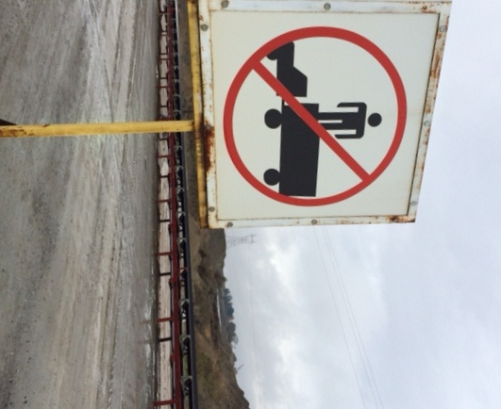
Do Not Climb on Trucks!
Only tarp or trim loads in designated areas.
The CA Vehicle Code specifically requires that aggregate plants designate a location for truckers to tarp or trim loads on the mine site.
Note: A designated location is not required if there is less than 100 yards from the scale house to the exit. At such locations, the truck may not travel more than 200 yards on public roads without tarping or leveling the load.

Slide 23
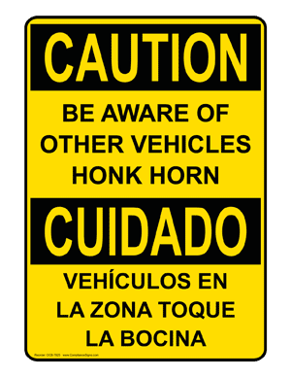
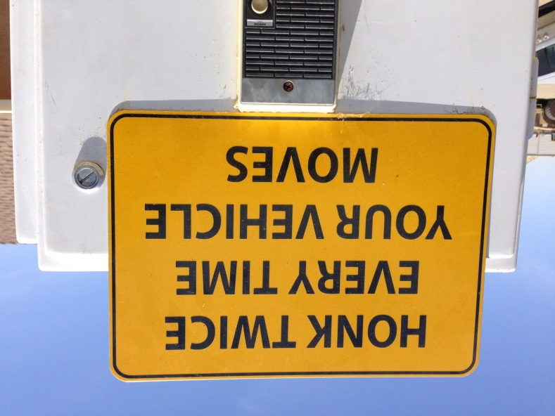
Honk Before Moving
MSHA requires that all trucks honk their horns when starting from a pro-longed stop (about 30 seconds).
Horns should also be honked prior to moving if there are other nearby hazards, such as blind spots, traffic, or people.
Horn honking protects miners and truckers who may be unaware that a truck is about to move.

Slide 24
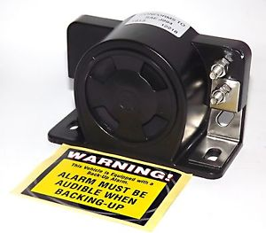
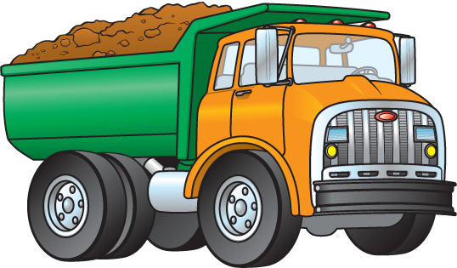
Have a Back-Up Alarm
The California Vehicle Code requires that trucks hauling aggregates, cement or other bulk materials be equipped with a working back-up alarm.
This is enforced by the California Highway Patrol through the biennial inspection of terminal (BIT).
In addition, both MSHA and CalOSHA enforce regulations for back-up alarms on mine sites.

Slide 25
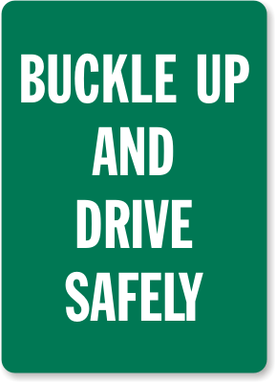
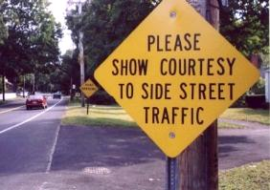
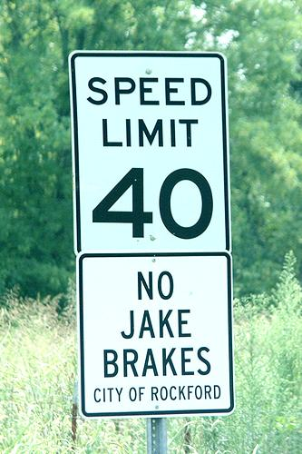
Exit a Mine Carefully
Remember to continue driving safely as you leave a mine site.
How truckers exit a mine and drive on the roads near a mine can be important to the home owners, farmers, businesses, and drivers in the local community.
Some mines will require wheel washing to reduce dust and track out from the mine. This helps keep the streets clean in the surrounding community.
Extend road courtesy to other vehicles at all times. Help the mine operator to be a good neighbor.

Slide 26
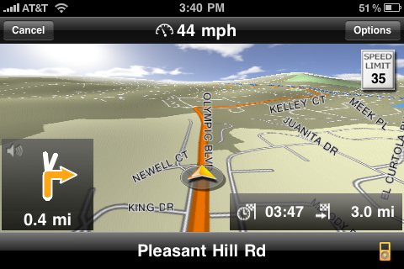
Know Your Routes
Be sure to know which roads to take to projects sites or batch plants.
Some communities will have special speed limits, routes for truck travel or limits during certain days or hours.
Pre-planning of trips saves time and makes for a safer trip.

Slide 27
REMEMBER!
Your safety matters.
We are part of a team that cares for each other’s safety.
With your help and cooperation, everyone gets to go home at the end of the day, safe and sound.
If you have any questions or concerns, please ask.

Slide 29
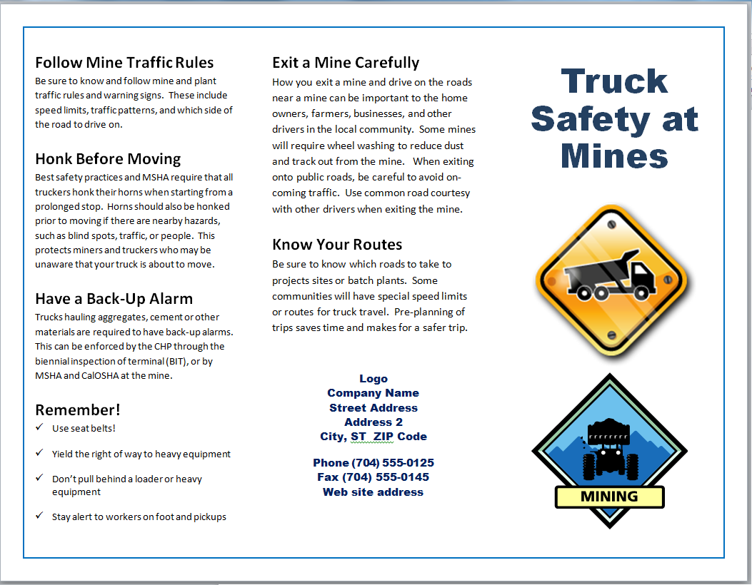
Publications – Brochure Front/Outside

Slide 30
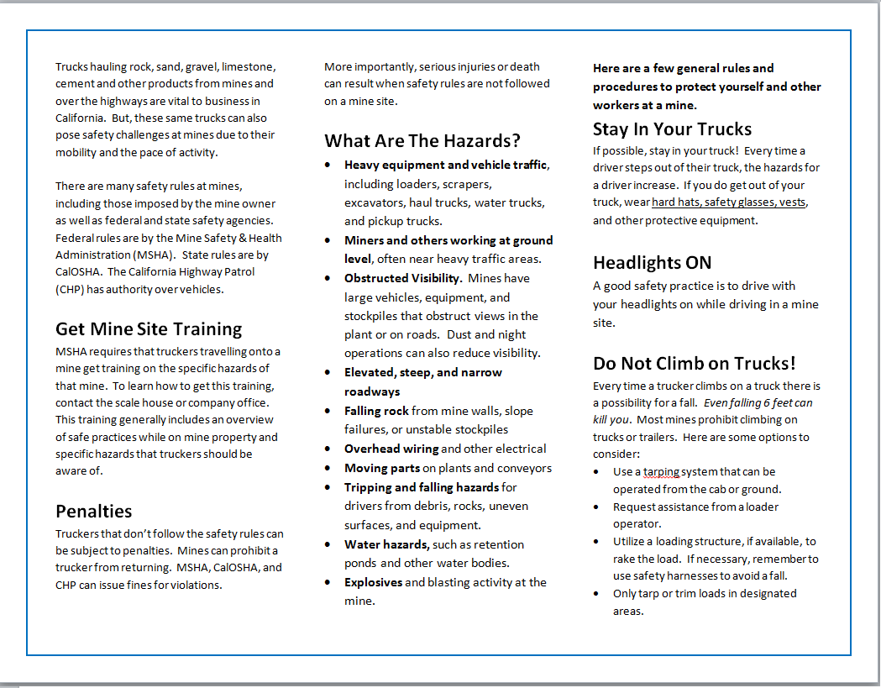
Publications – Back/Inside

Slide 31
Publications – Handout Card Front

Slide 32
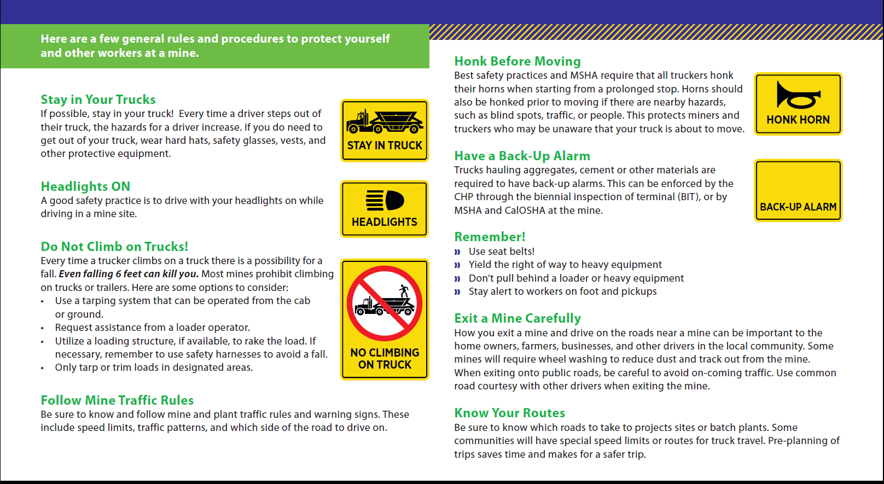
Publications – Handout Card Back

