Slide 1
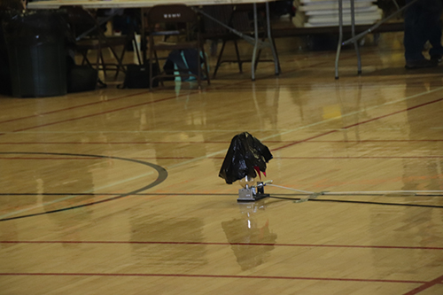
Ping Pong Parachute (B & C)
2022

Slide 2
Important!
Make sure that your pressure vessel (the bottle) is as specified in the rules:
  20 oz (no more, can be less)
  Carbonated beverage bottle (NOT A WATER BOTTLE)
  Must have a nozzle opening of approximately 2.2cm
  Must have a standard neck height of 1.6cm from flange to bottle opening
Bring the proper eye wear to the competition

Slide 3
Documentation
Flight logs and graphs should be done before the competition.
The graphs must have been printed from an electronic source – no hand drawn graphs allowed.

Slide 4
The Launcher
You will need a launcher to test your design.
Buy one at: https://www.nerdsinc.com/products
Build one: ?? (I think there were some designs out there, but I couldn’t find them this year)

Slide 5
Making the Ping Pong Parachute
Read the rules. Make sure you follow all of them.
Check the “Rule Clarifications” and “FAQs” at soinc.org
  These have the same authority as the original rules.
  Check back often as these change throughout the year.
If you are stuck or don’t know where to begin - there seems to be several YouTube videos about Ping Pong Parachute – keep in mind that these may show things that do not follow this year’s rules.

