Slide 1

Materials Science 2025

Slide 2
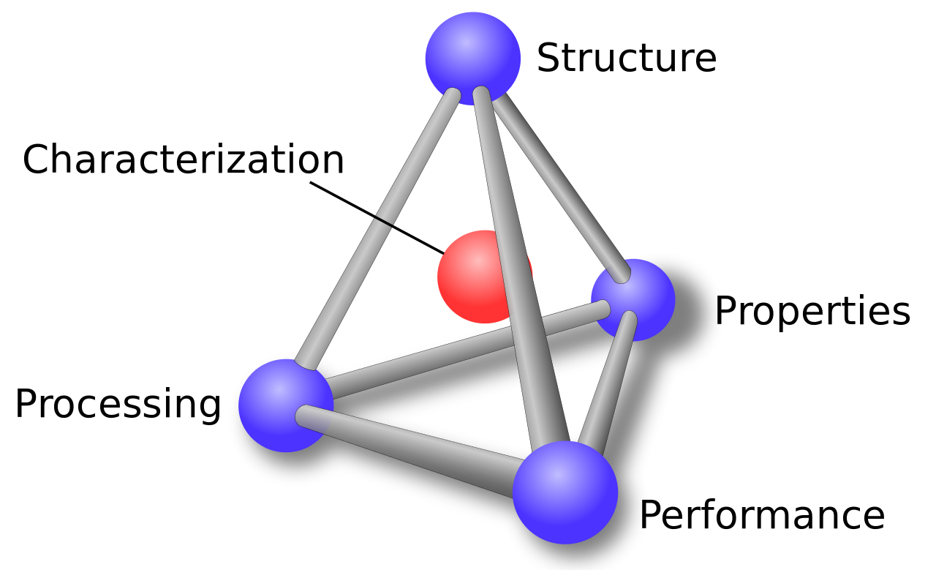
What is materials science?
Materials science is an interdisciplinary field focused on the study, design, and application of materials to solve real-world problems. It integrates principles from physics, chemistry, and engineering to understand the properties, structure, performance, and behavior of materials across a variety of applications. ~ChatGPT
Classification of Materials:
Metals – primarily composed of metallic elements
Ceramics – Compounds between metallic and nonmetallic elements
Polymers – Plastic and rubber materials
Composites – Composed of two or more individual materials from the above categories
Arrangement of a material’s internal components (electrons, atoms, molecules)
Methods to probe the structure and properties of the material
Traits of the material (mechanical, electrical, thermal)
How we make the material
How does the material behave?

Slide 3
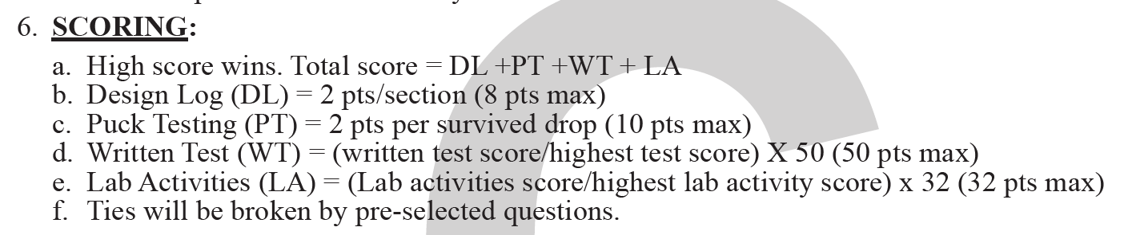
Materials Science is a 3 part event
Part 1: Concrete Puck testing (18% of score)
Part 2: Written Test (50% of score)
Part 3: Lab Activities (32% of score)

Slide 4
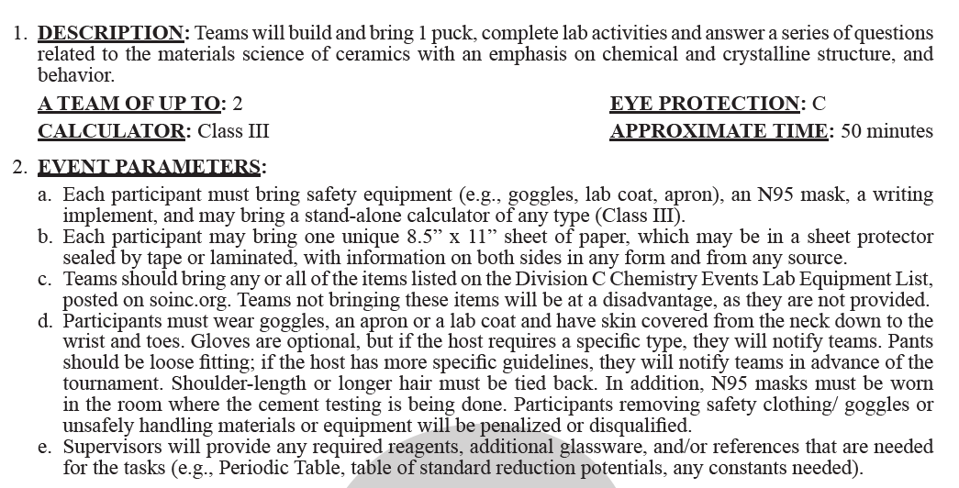
Event Parameters
Pay attention to “must bring” vs “may bring”
  Must bring: goggles, lab coat/apron, N95 mask, writing implement
  May bring: Class III calculator, 1 unique sheet of paper per participant, any or all of the items on the Div C Chemistry Events Lab Equipment List
There will be math! Strongly advise bringing calculator

Slide 5
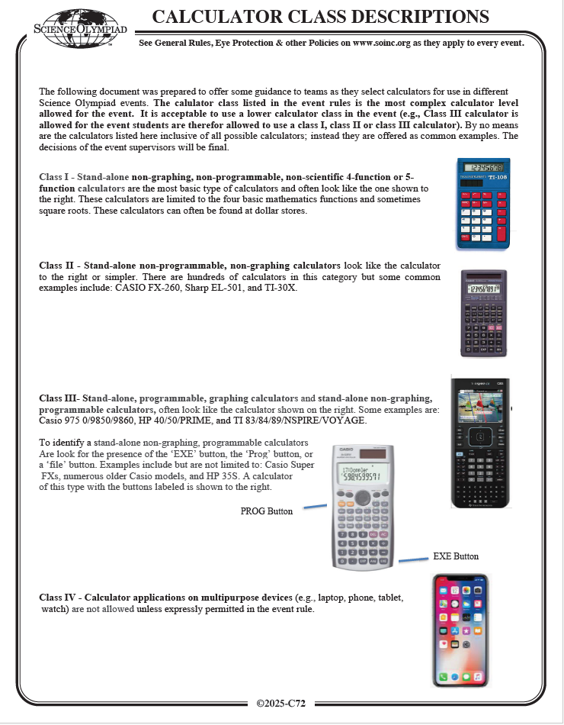
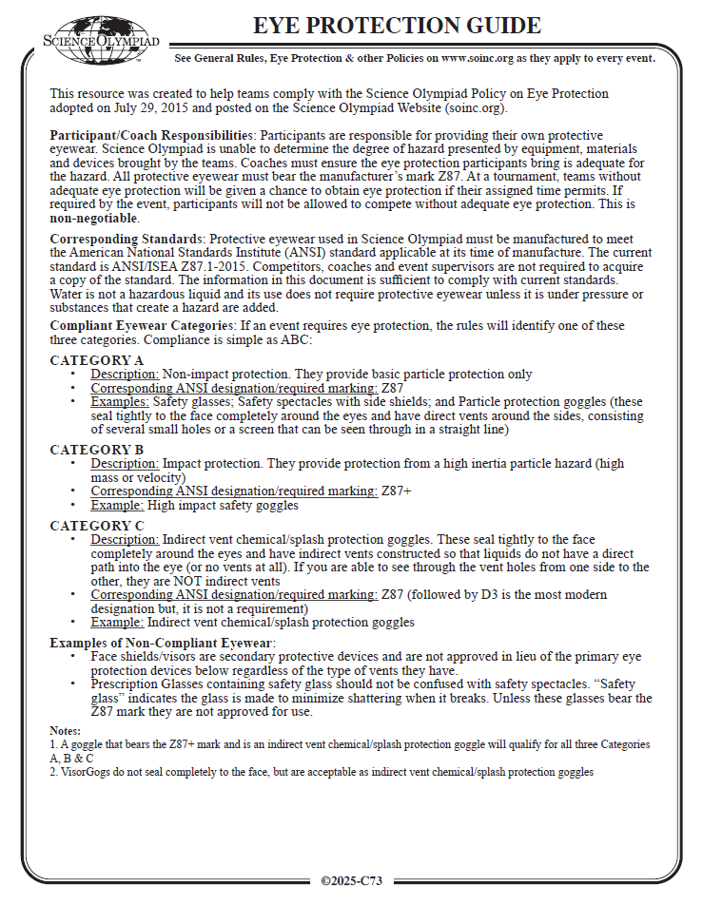
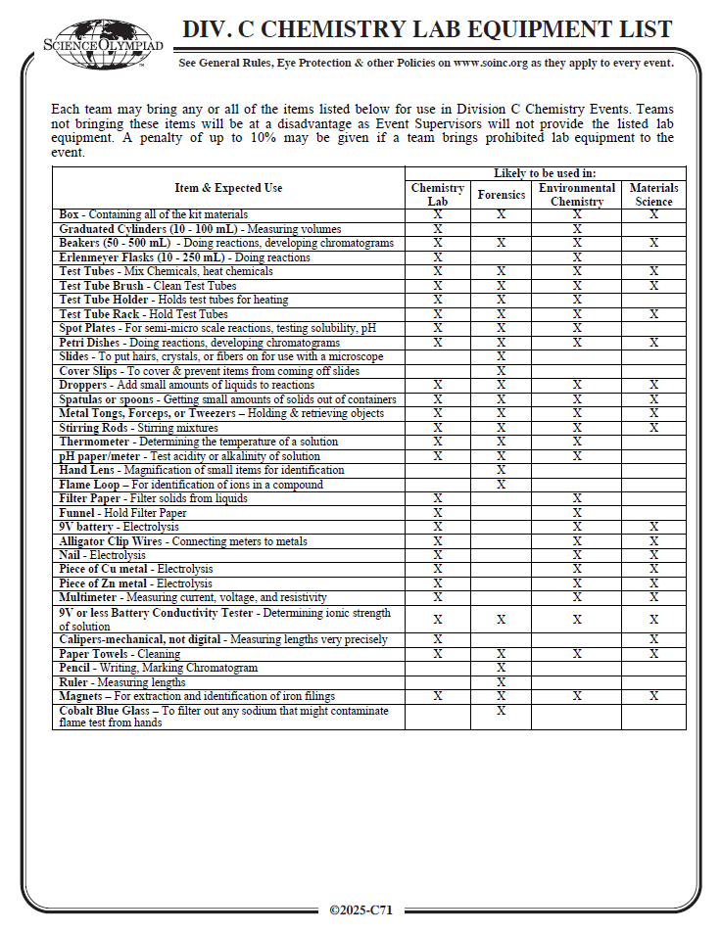
Event Parameters cont.
May bring any and or all of the items on this list
Phones not allowed for calculator

Slide 6
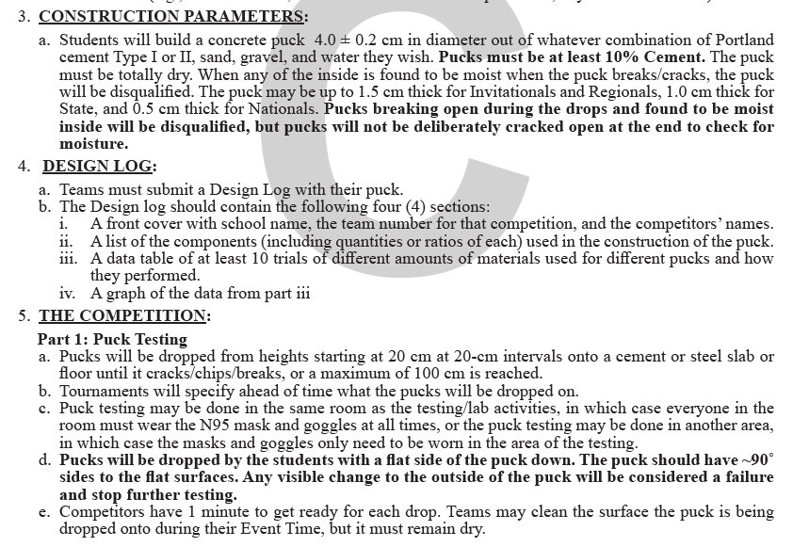
Part 1: Concrete puck testing
Specifics for puck construction
Pay attention to dimensions for regionals vs states
Pucks must be fully dry (do not wait until day before competition to make!)
Design log is easy 8 points! Must contain all 4 items in completeness
Must make 10 pucks ahead of competition with unique ratios of cement/sand/gravel/water
Each student must have N95 mask
2 pts for each height the puck survives; up to 5 heights for a total of 10 points
Practice! Practice! Practice!

Slide 7
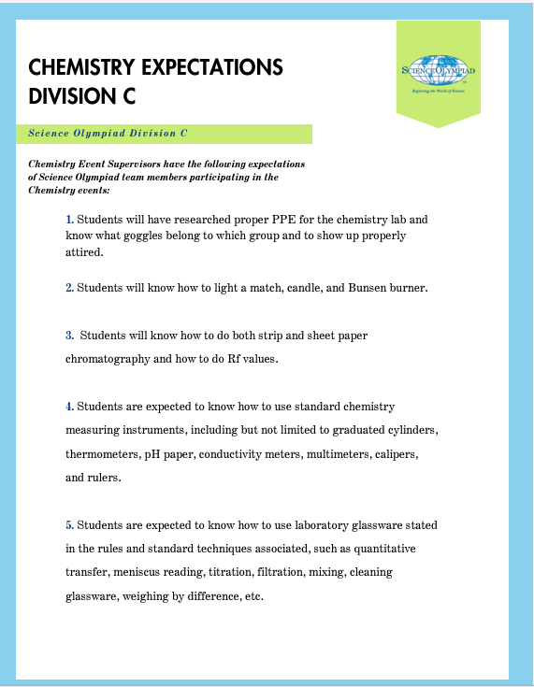
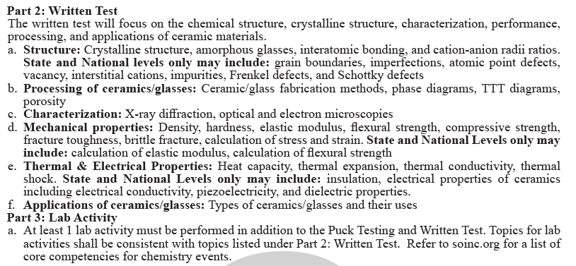
Part 2: Written Test
Part 3: Lab Activity
Participants are expected to be able to perform the following tasks for the lab activity
https://www.soinc.org/sites/default/files/uploaded_files/ChemistryExpeC.pdf

Slide 8
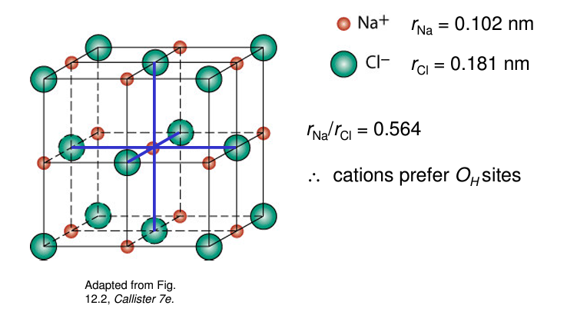
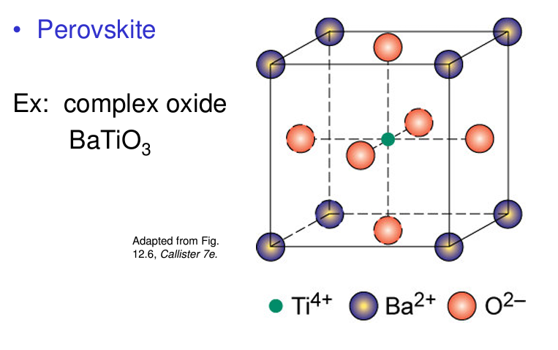
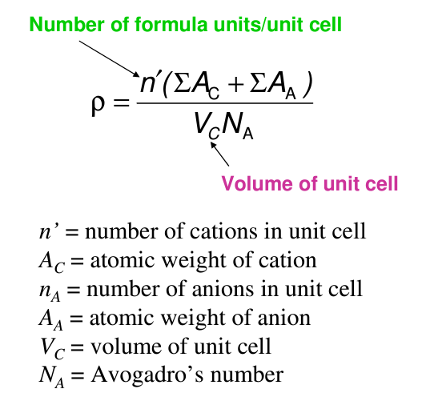
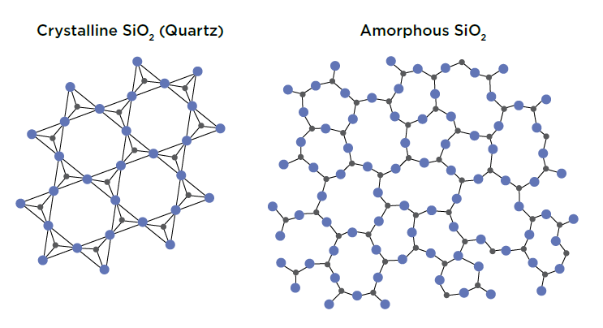
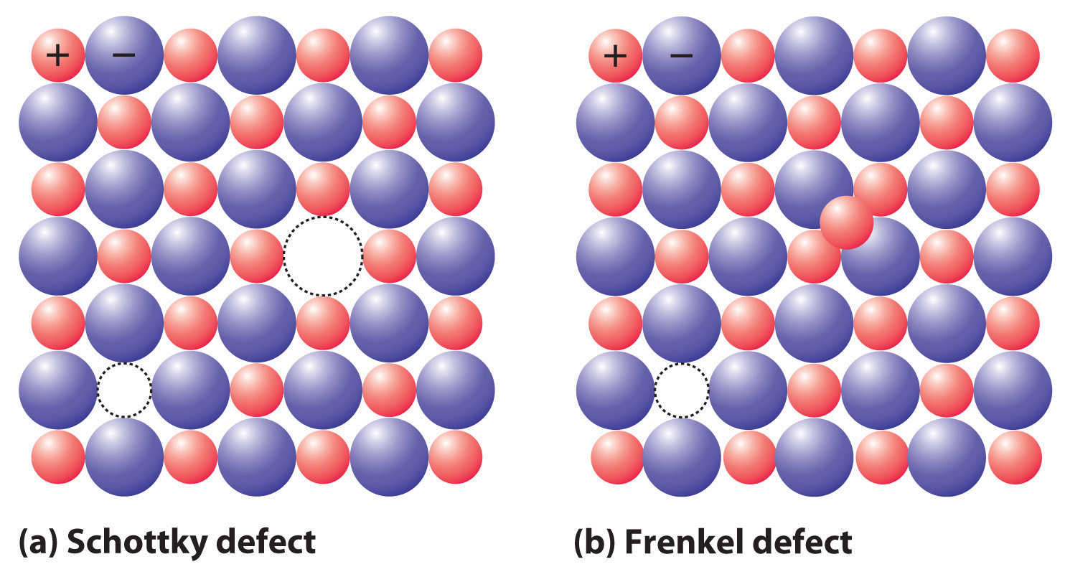
A. Structure
Common ceramic crystal structures:
Crystalline structure
Amorphous glasses
Interatomic bonding
Cation-anion radii ratios
State/National only:
  Grain boundaries
  Imperfections/atomic point defects/vacancy/interstitial cations/impurities
  Frenkel & Schottky defects
Density of ceramics:
Crystalline vs Amorphous
Defects:

Slide 9

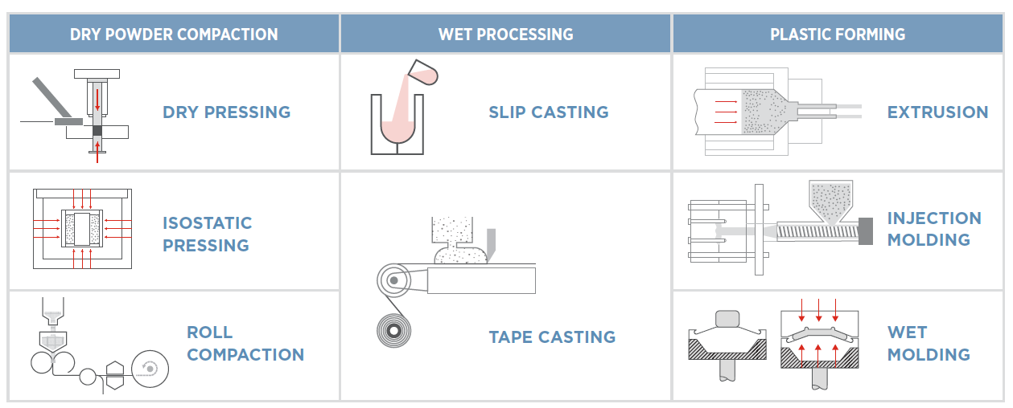
B. Processing of ceramics/glasses
Ceramic/glass fabrication methods
Phase diagrams
TTT (Time-Temperature-Transformation) diagrams
Porosity

Slide 10
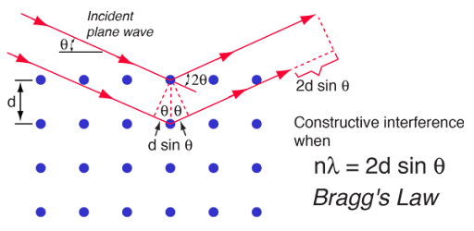
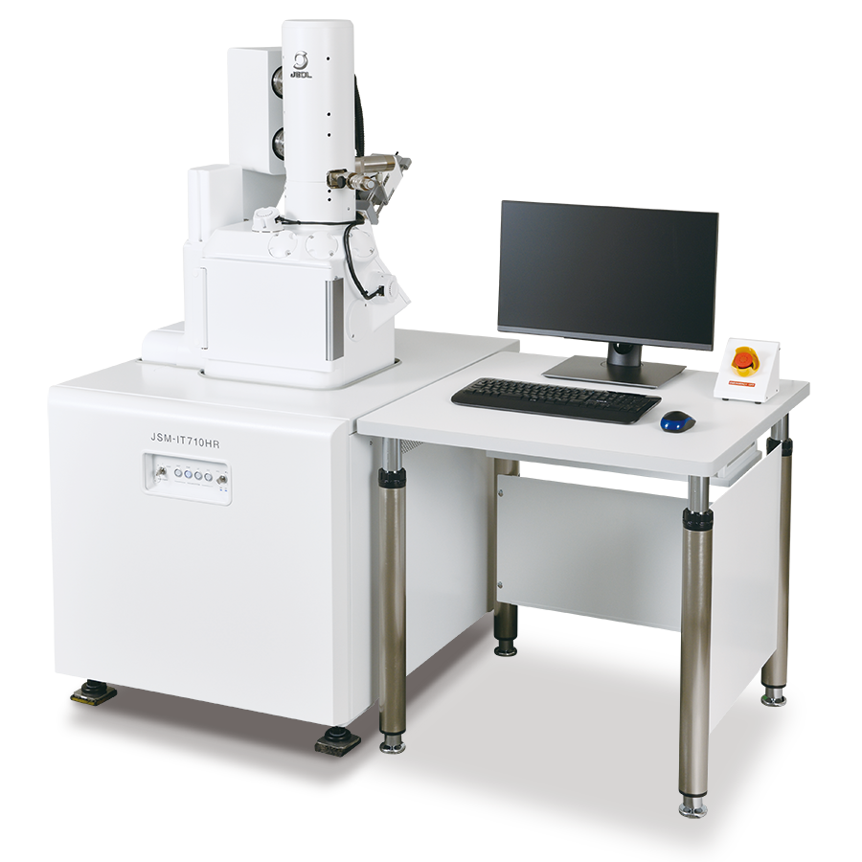
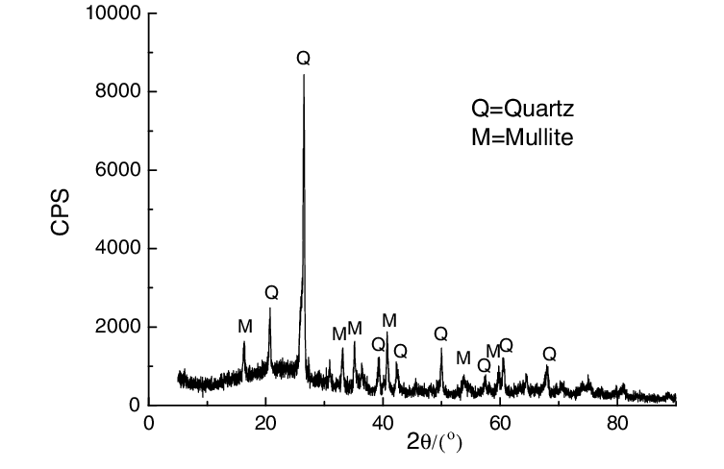
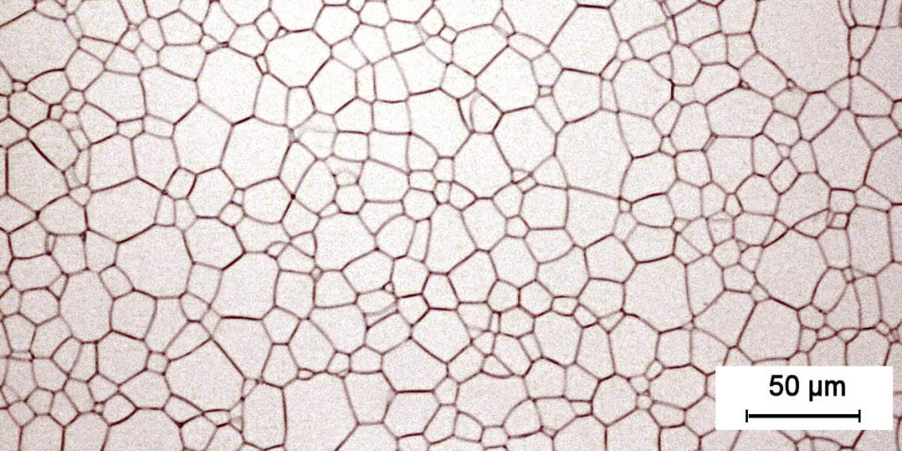
C. Characterization
X-ray diffraction is based on Bragg’s law:
Scanning electron microscope:
X-ray diffraction
Light optical microscopy
Electron microscopy
Sample X-ray diffraction plot for a ceramic:
Image taken on an optical microscope of a ceramic showing grain boundaries:

Slide 11
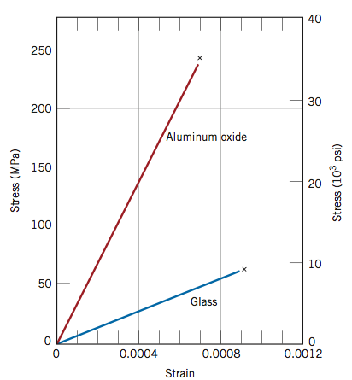
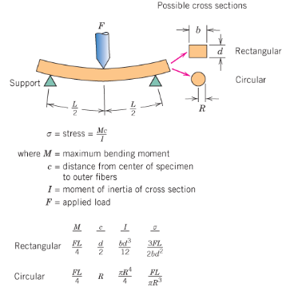



D. Mechanical Properties
Calculation of stress:
Calculation of strain:
$$σ=\frac{F}{A}$$
$$ε=\frac{∆l}{l_{0}}$$
Density
Hardness
Elastic Modulus
Flexural Strength
Compressive Strength
Fracture toughness
Brittle fracture
Calculation of Stress and Strain
State and National Only:
  Calculation of elastic modulus
  Calculation of flexural strength
σ = stress
F = load
A = cross-sectional area
ε = strain
Δl = change in length
l₀ = original length
Calculation of flexural strength:
$$σ_{fs}=\frac{3F_{f}L}{2bd^{2}}$$
σ_{fs} = flexural strength
F_{f} = load at fracture
L = distance between support points
b & d = dimensions of rectangle

Slide 12

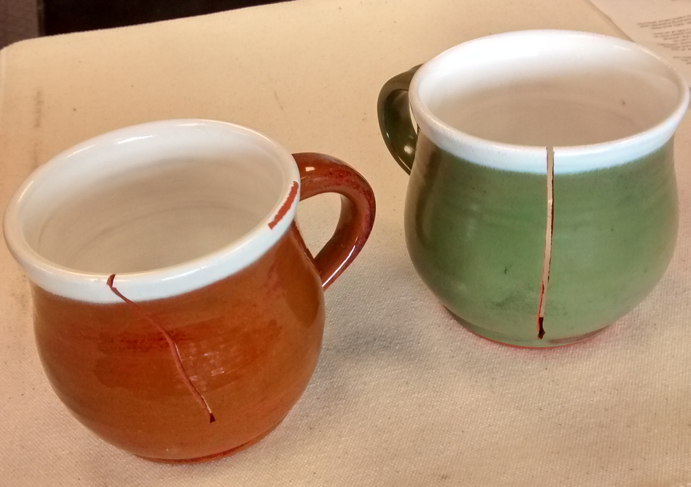

E. Thermal/Electrical Properties
Ceramics typically have low thermal conductivity:
Thermal Properties
  Heat Capacity
  Thermal Expansion
  Thermal Conductivity
  Thermal Shock
State and National only, electrical properties:
  Insulation
  Electrical conductivity
  Piezoelectricity
  Dielectric Properties
Calculation of thermal
expansion:
$$\frac{∆l}{l_{0}}=α∆T$$
Δl = Change in length
L₀= Original length
α = linear coefficient of thermal expansion
ΔT = change in temperature
Thermal shock:

Slide 13

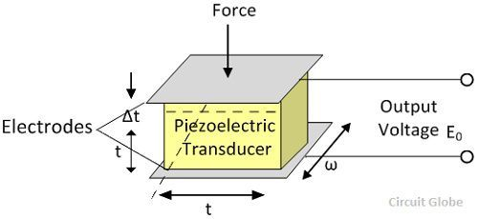

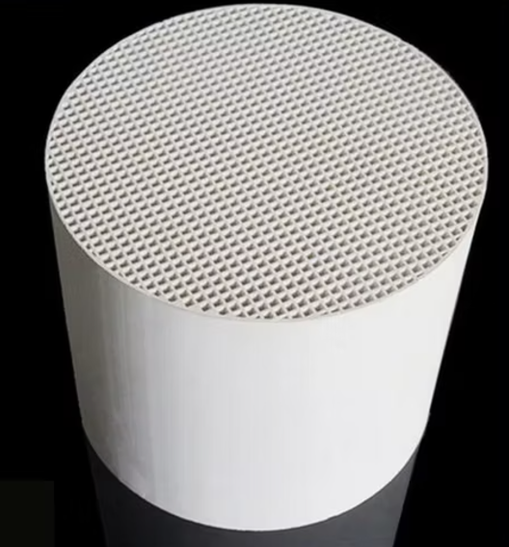
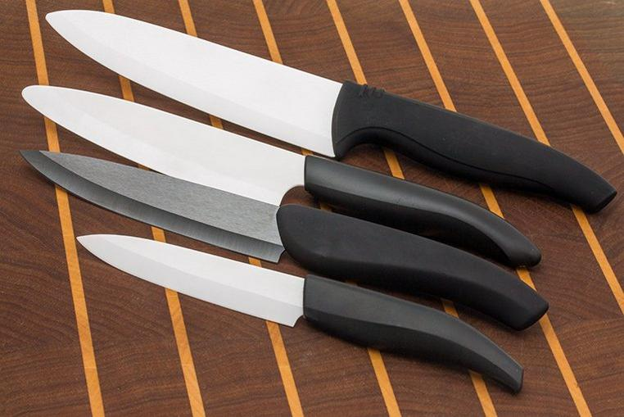
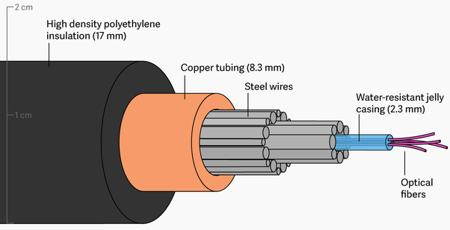


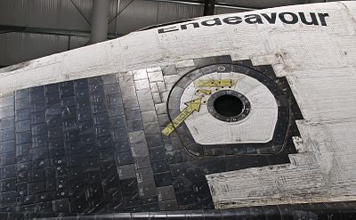
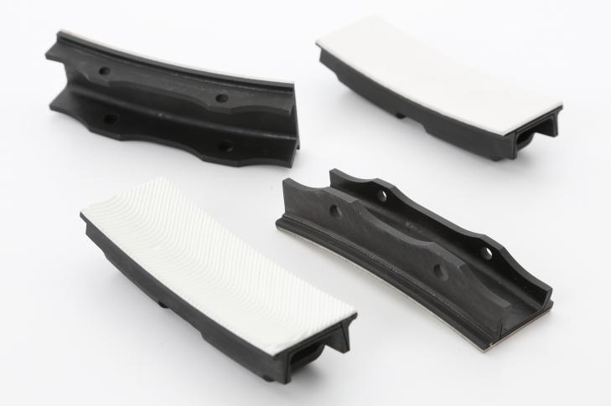
F. Applications of Ceramics/Glasses
Boron carbide body armor:
Piezoelectric transducer:
Catalytic converter scaffold:
Fiber optic cable:
Spark Plugs Insulator:
Space Shuttle Heat Shield Tiles:
Silicon carbide jet engine parts/coatings:

Slide 14
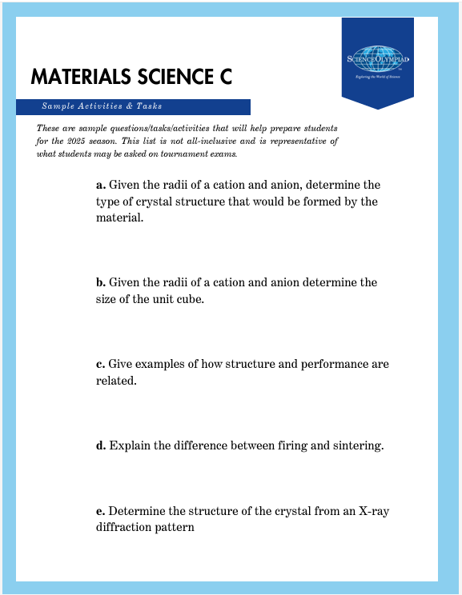
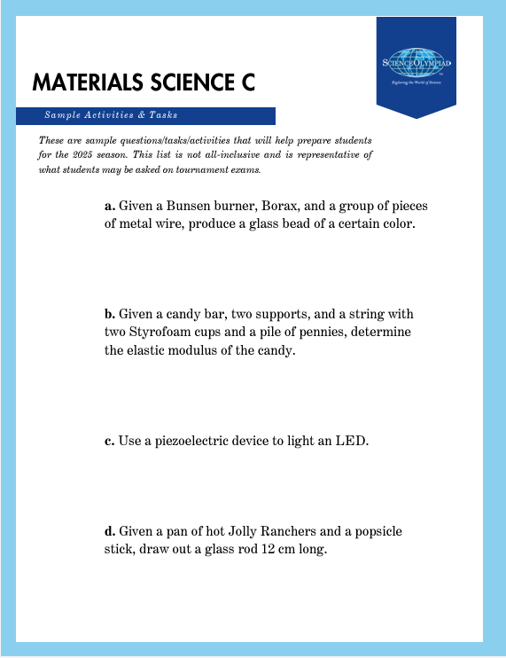
Check the soinc.org website for resources
Check soinc website for resources: https://www.soinc.org/materials-science-c
Sample activities/questions on soinc:
https://www.soinc.org/sites/default/files/uploaded_files/MaterialsScienceC25.pdf

Slide 15
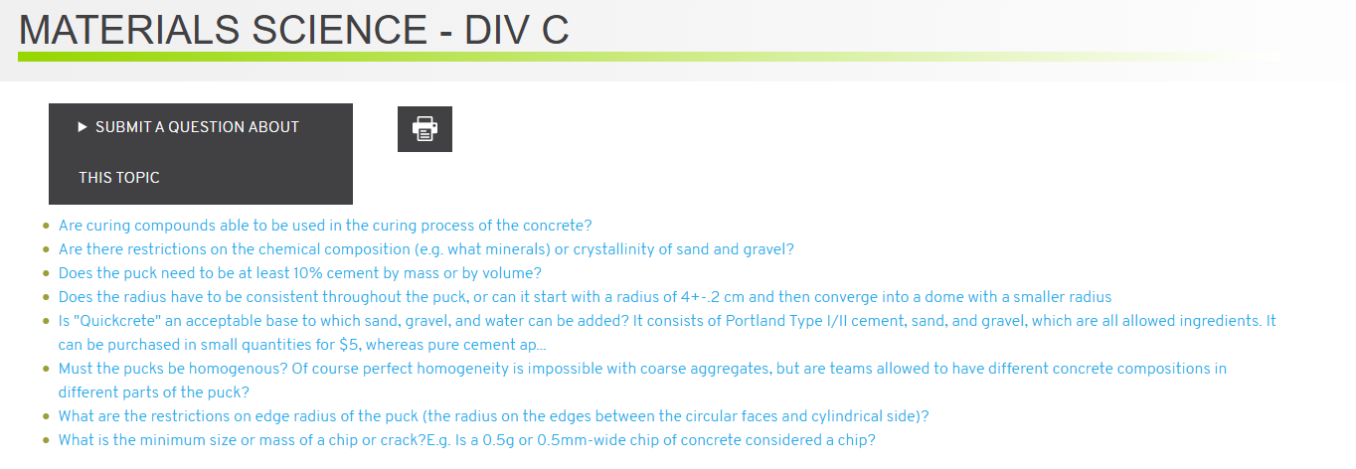
FAQs on soinc.org
https://www.soinc.org/faq/materials-science-div-c
Many questions have already been answered about the concrete puck testing
Can submit additional questions

Slide 16
Some other great resources
The American Ceramics Society (ACerS)
  Ceramics and glass in industry and everyday life. - The American Ceramic Society
  Free Downloadable Lessons - The American Ceramic Society
  https://ceramics.org/professional-resources/teachers/#sign-up
Coorstek
  https://www.coorstek.com/en/resources/brochures-datasheets/
    The two Ebooks, "Ceramics: The Powerhouse of Advanced Materials" and "A View to a Kiln: Methods & Processes for Ceramics Manufacturing" are both free downloads
Morgan Advanced Materials
  "Ceramics 101": https://www.morgantechnicalceramics.com/en-gb/ceramics-101/
Kopp Glass
  https://go.koppglass.com/hubfs/glass_properties_ebook_Kopp_Glass.pdf?hsCtaTracking=e6258e4b-0559-409a-8839-ee60fe29169d%7C7bc409aa-9015-4f71-b7ac-e7cbb7b366e1
Corning
  https://www.corning.com/worldwide/en.html
Materialism Podcast: A podcast run by University of Utah Materials Science Professor and Graduate Students
  https://materialismpodcast.com/episodes.html
    Episodes relevant to event: 10, 11, 34, 35, 55, 56, 63, 66, 73, 80

Slide 17
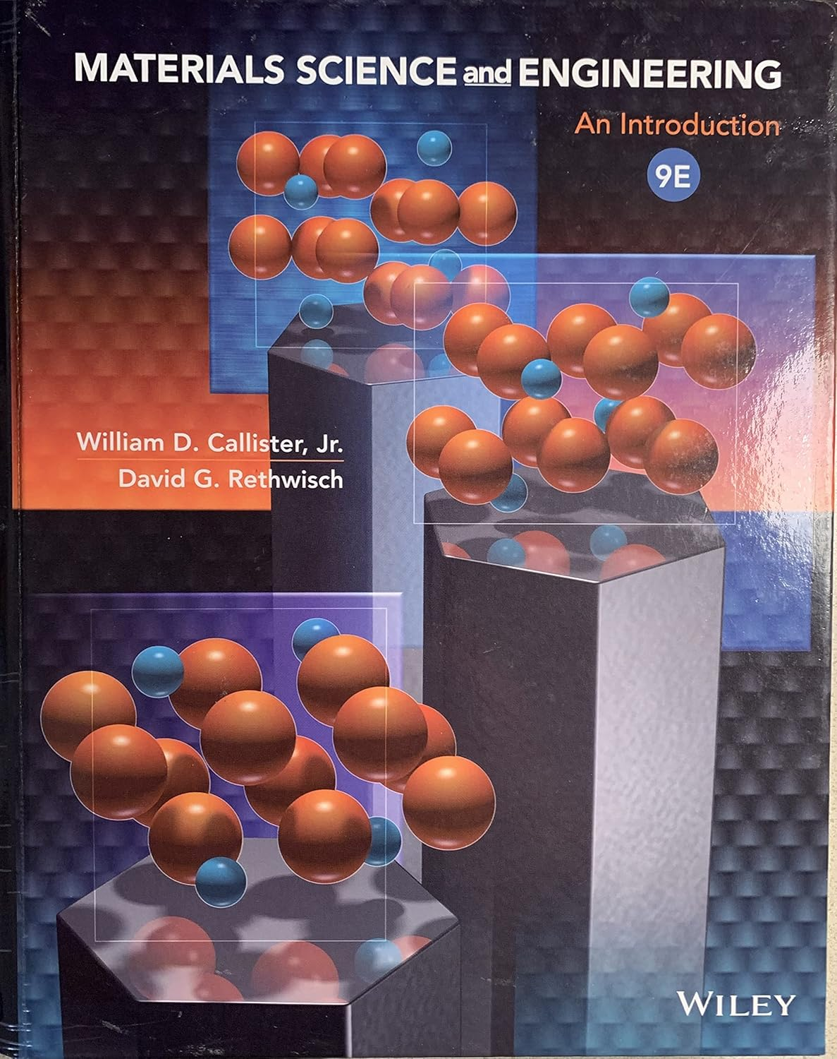
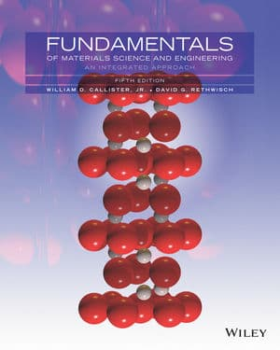
Some other great resources
Materials Science and Engineering, An Introduction by William Callister and David Rethwisch
Fundamentals of Materials Science and Engineering, An Integrated Approach by William Callister and David Rethwisch
Older editions are <$10 on Ebay!!

Slide 18
Thank you!

